Slide 1
Memristors by Quantum Mechanics
Thomas Prevenslik
QED Radiations
Discovery Bay, Hong Kong
1
Notes:
Enter speaker notes here.

Slide 2
Introduction
In 1971, Chua claimed a passive two-terminal circuit element having a resistance that depended on the time–integral of the current
Symmetry suggested the 3 elements – resistor, capacitor, and inductor needed a fourth element for completeness called:
Memristor
2

Slide 3
Background
In 2008, Hewlett-Packard (HP) announced a working memristor comprising a thin film of TiO2 between Pt electrodes
The memristor is basically a variable resistor dependent on the current I that flows by the amount of charge Q transferred.
Q = ∫ I dt
3

Slide 4
Source of Charge
HP claim the charge is caused by oxygen vacancies in the TiO2 that act as positive charge holes moving under the bias voltage that change the memristor resistance during the cycle
But memristor behavior has been observed without oxygen vacancies in molecular layers between gold electrodes and in single materials without electrodes, e.g., silicon nanowires
Lacking vacancies, explanations of memristor behavior assume the presence of space charge, but the mechanism by which the space charge is produced is not identified.
4

Slide 5
Space Charge by QM
QM creates charge Q anytime EM energy is absorbed at the nanoscale – Classical physics does not produce charge.
For memristors, the EM energy is Joule heating absorbed in the thin nanoscale film.
But QM requires the heat capacity of the thin film to vanish so the Joule heat cannot be conserved by an increase in temperature.
Instead, conservation proceeds by the QED induced creation of photons inside the film.
QED photons create charge Q by Einstein’s photoelectric effect.
5

Slide 6
QM Size Effect
Memristor behavior only observed at the nanoscale. (Thin films, nanowire, etc)
At the macroscale, memristors behave like ordinary resistor where resistance is voltage divided by current.
QM restrictions at ambient temperature apply to submicron structures < 1 micron
6

Slide 7
Memristor Geometry
D
D
+
t
QED Radiation
t
+
QED Radiation
d
L
d
t
-
-
t
I
I
I
Thin Film
Nanowire
7

Slide 8
Classical v. QM Heat Capacity
Classical Statistical Mechanics
kT 0.0258 eV
QM
Nanoscale
8

Slide 9
Conservation by QED
QED induces up-conversion of the absorbed EM energy to the TIR confinement frequency of the memristor. TIR total internal reflection
Memristors have high surface to volume ratios so most EM energy absorbed in surface
TIR confinement only occurs during absorption - sustains itself
f = c / n / λ E = h f
f = TIR confinement frequency E = Planck energy c = light speed n_{r} = refractive index h = Planck’s constant
λ = 2 nr Dc ; Dc = d thin film, D nanowire
9

Slide 10
Excitons (Holes, Electrons)
$$\frac{dQ_{E}}{dt}=\frac{ηP}{E}−\frac{μ_{E}V}{d}Q_{E}$$
10

Slide 11
Resistance, Voltage, Current
ω/2π =1 GHz
μ_{E} = μ_{H} = 500 cm²/V-s
P = 10 mW, V= 1V, R_{O} = 100 Ω, I = 10 mA
E = 4 eV, A = 200x200 nm², d = 50 nm
11

Slide 12
Resistance and Current
12

Slide 13
Current - Voltage
13

Slide 14
Updated Results
μH = 0.002 to 0.05 m2/V-s
μH = 0.00002 m2/V-s
Current – Voltage Characteristics of a Memristor
Y. N. Joglekar and S. Wolfram
14

Slide 15
Conclusions
Modern day electronics was developed based on macroscale response of resistors, but a QM approach is suggested at the nanoscale where memristive effects are observed.
QED radiation precludes any temperature increase to conserve Joule heat. Conservation proceeds by the creation of QED photons that by Einstein’s photoelectric effect create excitons, the positive charged holes of which produce the memristive effect.
Memristors are a QM size effect and have nothing to do with the missing fourth element necessary for the symmetry of the resistor, capacitor, and inductor.
15

Slide 16
QED Extensions
Molecular Dynamics
Heat transfer simulations invalid for discrete nanostructures
Big Bang Theory QED Redshift in cosmic dust means Universe is not expanding
16

Slide 17
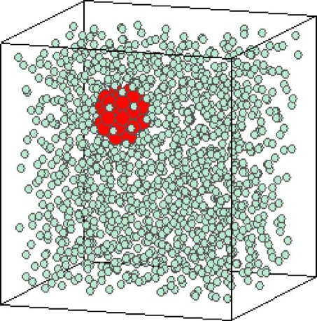
Molecular Dynamics
Akimov, et al. “Molecular Dynamics of Surface-Moving Thermally Driven Nanocars,”
J. Chem. Theory Comput. 4, 652 (2008).
Discrete → kT = 0, but kT > 0 assumed
Car distorts but does not move
Macroscopic analogy
Instead, QM forbids any increase in car temperature. Hence, QED radiation is produced that by the photoelectric effect charges the cars that move by electrostatic interaction with each other.
Sarkar et al., “Molecular dynamics simulation of effective thermal conductivity and study of enhance thermal transport in nanofluids,”
J. Appl. Phys, 102, 074302 (2007).
Periodic Boundary Conditions
kT > 0, valid
Metropolis & Teller, 1950
17

Slide 18
Big Bang Theory
In 1929, Hubble measured the redshift of galaxy light that based on the Doppler Effect showed the Universe is expanding.
However, cosmic dust which is submicron NPs permeate space and redshift galaxy light without Doppler effect.
18

Slide 19
QED Induced Redshift
Classical Physics – Absorbed galaxy photon increases NP temperature
19

Slide 20
Effect on Cosmology
The redshift: Z = (λ_{o} - λ)/λ > 0 occurs without the Universe expanding.
Astronomers will not find the dark energy to explain an expanding Universe which is not expanding
Suggests a return to a static infinite Universe once proposed by Einstein.
20

Slide 21
Questions & Papers
Email: nanoqed@gmail.com
http://www.nanoqed.org
21
Notes:
Enter speaker notes here.

