Slide 1
Heat Transfer in Nanoelectronics by
Quantum Mechanics
Thomas Prevenslik
QED Radiations
Discovery Bay, Hong Kong
1
Notes:
Enter speaker notes here.

Slide 2
Introduction
Today, Fourier’s equation based on classical physics is routinely applied to heat transfer in nanoelectronics - resistors, capacitors, and inductors - having submicron dimensions.
However, unphysical results are found.
Memristors require oxygen vacancies
( Behaviour observed w/o vacancies )
Resistance change in PCRAM devices caused by melting
( Melting can not create discrete charge )
Hooge relation gives 1/f noise by electron collisions w lattice
( Frequencies << lattice frequencies )
[1] L. O. Chua, “Memristor - the missing circuit element,” IEEE Trans. Circuit Theory, vol. 18, pp. 507–519, 1971.
2

Slide 3
Proposal
Heat transfer in nanoelectronics is a QM effect that conserves Joule heat by producing QED radiation instead of the usual increase in temperature.
QM = Quantum Mechanics
QED = Quantum electrodynamics
QED radiation creates excitons (hole and electron pairs), the holes separating from electrons In the electric field across the circuit element,
Holes lower resistance of circuit element
or
upon recombination with electrons emit EM radiation.
EM = Electromagnetic
3

Slide 4
Theory
Heat Capacity of the Atom
Conservation of Energy
TIR Confinement
QED Induced Heat Transfer
4

Slide 5

Heat Capacity of the Atom
Classical Physics (kT > 0)
MEMS
kT 0.0258 eV
QM
(kT = 0)
NEMS
In MEMS, atoms have heat capacity, but not in NEMS
5

Slide 6
Conservation of Energy
Lack of heat capacity by QM precludes Joule heat conservation in NEMS by an increase in temperature, but how does conservation proceed?
Proposal
Absorbed EM energy is conserved by creating QED radiation and excitons inside the circuit element - by frequency up - conversion to the TIR resonance of the circuit element.
TIR = Total Internal Reflection
6

Slide 7
TIR Confinement
Since the refractive index of nanoelectroncs is > surroundings, the QED radiation is confined by TIR
Circuit elements ( films, wires, etc) have high surface to volume ratio, but why important? Magic of NPs.
By QED, EM energy absorbed in the surface of circuit elements creates EM radiation in the TIR mode of the surface.
Magic of NPs is the chemical reactions induced from the conversion of absorbed EM energy to QED radiation
f = (c/n) / λ and E = hf
For thin film circuit elements having thickness d, λ = 2d
7

Slide 8



QED Heat Transfer
EM
Radiation
$Q_{abs}−\text{QED} \text{radiation}=Q_{cond}$
QED radiation → Excitons = EM radiation + Charge
Conservation by QED radiation is very rapid
Qabs is conserved before thermalization only after which may phonons respond
$Q_{abs}=$ $\text{QED} \text{radiation}$
No thermal conduction
$Q_{cond}$ → 0
Fourier and BTE solutions are meaningless
Conductivity remains at bulk
QED
Radiation
Charge
Excitons
$$Q_{abs}$$
ΔT = 0
Phonons
NEMS
Circuit
Element
Qcond
Substrate
8

Slide 9
Response
Exciton Source and Loss
Exciton Dynamics
Resistance and Current
9

Slide 10


Excitons Source and Loss
Exciton Source
P = Joule heat
E = QED Photon energy
= Fraction of P absorbed in Element (1-η) = Fraction of P loss to Surroundings
Exciton Loss to Electrodes
Q = Number of Excitons
μ = Mobility
V = Voltage
d = thickness
10

Slide 11




Exciton Dynamics
Electrons
Holes
Where, QE and QH are number electrons and holes, V is the voltage μE and μH are electron and hole mobility, and d thickness
For memristors, V = Vo sin ωt.
For Ovshinsky effect and 1/f Noise, V = Vo,
11

Slide 12



Resistance and Current
σ = Conductivity ρ = Resistivity
12

Slide 13
Applications
Memristors
Ovshinsky effect
1/f Noise
Optimum Circuit Design
13

Slide 14
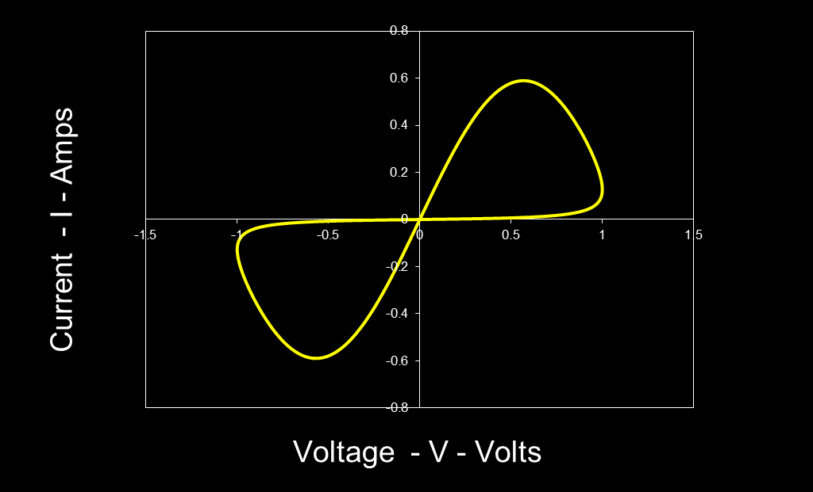
Memristors
d = 50 nm , GST mobility μ_{H} = 2x10⁻⁶ cm²/V-s
QED creates charge to lower Memristor resistance
( Oxygen vacancies not required)
14

Slide 15
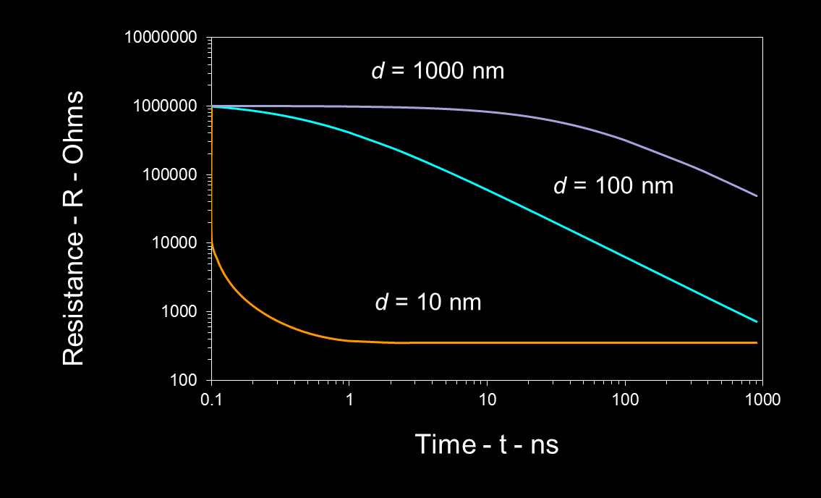
Ovshinsky Effect
Alq3 Mobility μ = 2x10⁻⁵ cm²/V-s, Vo = 1 V, Ro = 1 MΩ
QED charge lowers PCRAM resistance
( Melting is inconsequential)
15

Slide 16

1/f Noise in Nanowires
SnO2 NWs
d = 50 nm μ_{H} = 172 cm²/V-s
16

Slide 17

1/f Noise in Nanowires
Step in QED Induced Charge → Step in Current → Step in Power
Fourier Transform of Step in Power P(t) gives 1/f Noise
P(t)
t →
0
Step change in time domain → 1/f noise in frequency domain
Music and Stock Market prices recordings?
17

Slide 18
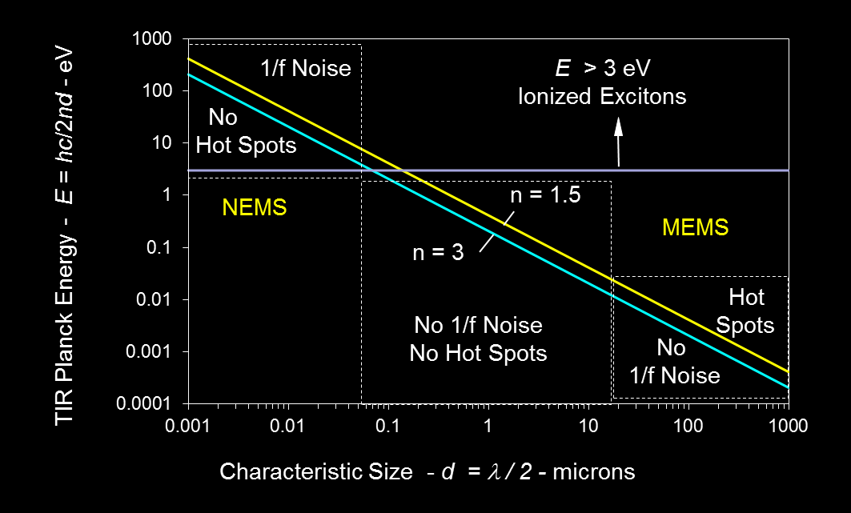
Optimum MEMS/NEMS Design
Optimum Design 0.05 < d < 20 microns
Fourier equation and BTE invalid → Use QED heat transfer
18

Slide 19
Conclusions
By QM, NEMS circuit elements do not increase in temperature because Joule heat is conserved by the creation of charge.
QED induced charge supersedes:
• Oxygen vacancies in memristors
• Melting in PCRAM
• The Hooge relation in 1/f noise
Optimum NEMS/MEMS circuit design 0.05 < d < 20 microns avoids both hot spots and 1/f noise
19

Slide 20
Questions & Papers
Email: nanoqed@gmail.com
http://www.nanoqed.org
20
Notes:
Enter speaker notes here.

