Slide 1
Validity of Molecular Dynamics Heat Transfer by Quantum Mechanics
Thomas Prevenslik
QED Radiations
Discovery Bay, Hong Kong, China

Slide 2
Introduction
Molecular Dynamics MD is commonly used to simulate heat transfer at the nanoscale in the belief:
Atomistic response using L-J potentials (ab initio) is more accurate than macroscopic finite element FE programs, e.g., ANSYS, COMSOL, etc.
In this talk, I show:
FE gives equivalent heat transfer to MD, but both are invalid at the nanoscale by quantum mechanics QM
And present:
Invalid and valid MD solutions by QM

Slide 3
MD and FE Restrictions
MD and FE are restricted by SM to atoms having thermal heat capacity
SM = statistical mechanics

Slide 4
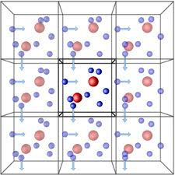
Validity
Historically, MD simulations of the bulk performed under periodic boundary conditions PBC assume atoms have heat capacity
In the macroscopic bulk being simulated, all atoms do indeed have heat capacity
MD is therefore valid for bulk PBC simulations

Slide 5
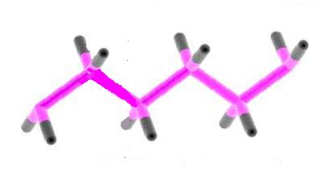
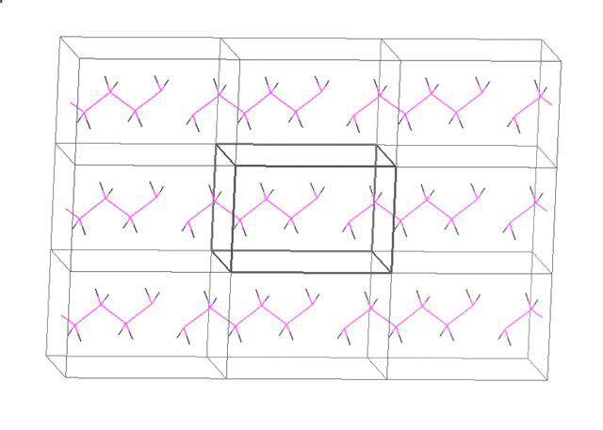
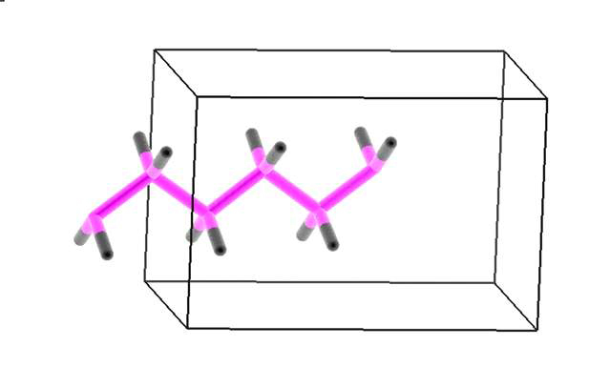
Discrete and Periodic BCs
Discrete
PBC
Computation Box

Slide 6
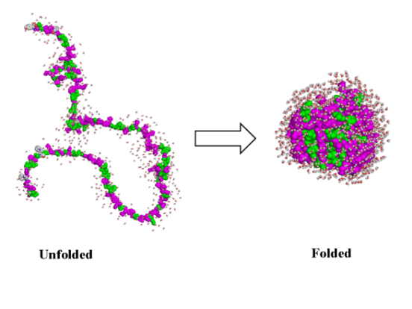
Problem
Today, MD is not used for bulk simulations, but rather for the atomistic response of discrete molecules and nanostructures
Problem is MD programs based on SM assume the atom has heat capacity, i.e.; temperature changes allowed in folding proteins.
But QM forbids temperature changes → unphysical results, e.g.,
Conductivity in Thin films depends on thickness
Nanofluids violate mixing rules, etc
Why is this so?
Protein Folding
Pretty Pictures
Folded
Unfolded

Slide 7
Heat Capacity of the Atom
$$E= \frac{\frac{hc}{λ}}{exp\left(\frac{hc}{λkT}\right)−1}$$
Nanoscale - MD
Macroscale – FE
Classical physics E = kT at macro and nanoscale
QM kT → 0 at nanoscale

Slide 8
Quantum Corrections
The vanishing heat capacity in the Einstein-Hopf of QM is consistent with making QCs of heat capacity to MD solutions.
QC = quantum corrections
See Allen and Tildesley - Computer Simulations of Liquids, 1987.
QCs show heat capacity vanishes in MD solutions , but is ignored.
An uncountable nunber of invalid MD solutions in literature

Slide 9
Conservation of Energy
Lack of heat capacity by QM precludes EM energy conservation in discrete molecules and nanostructures by an increase in temperature, but how does conservation proceed?
Proposal
Absorbed EM energy is conserved by creating QED induced excitons (holon and electron pairs) at the TIR resonant frequency.
_{QED = Quantum Electrodynamics}
TIR = Total Internal Reflection
_{EM = Electromagnetic}
Upon recombination, the excitons emit EM radiation that charges the molecule and nanostructure or is lost to the surroundings.

Slide 10
TIR Confinement and QED
In 1870, Tyndall showed photons are confined by TIR in the surface of a body if the refractive index of the body is greater than that of the surroundings.
Why important?
Nanostructures have high surface to volume ratio.
Absorbed EM energy is concentrated almost totally in the nanostructure surface that coincides with the mode of the TIR photon.
Under TIR confinement, QED induces the absorbed EM energy to spontaneously create excitons
f = (c/n)/λ λ = 2D E = hf
D = diameter of NP or thickness of film
But a Feynman QED derivation the TIR frequency is required.
Any interested students?
8

Slide 11
QED Heat Transfer
EM
Radiation
$Q_{abs}−Q_{Excitons}=Q_{cond}$
QED Excitons = EM radiation + Charge
Conservation by QED Excitons is very rapid
Qabsis conserved before thermalization only after which phonons respond
$$Q_{abs}=Q_{Excitons}$$
No thermal conduction
$Q_{cond}$ → 0
Fourier temperatures in NP are meaningless
Conductivity remains at bulk
Charge
Excitons
NP
$$Q_{abs}$$
Phonons
Surface
Qcond
9

Slide 12
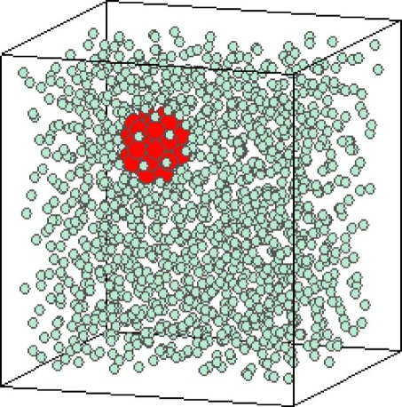
MD - Discrete and PBC
Akimov, et al. “Molecular Dynamics of Surface-Moving Thermally Driven Nanocars,”
J. Chem. Theory Comput. 4, 652 (2008).
MD for Discrete → kT = 0, But MD assumes kT > 0
Car distorts but does not move
Macroscopic analogy,
FE Simulations → Same as MD
Classical Physics does not work
QM differs
No increase in car temperature
Charge is produced by excitons
Cars move by electrostatic interaction
Sarkar et al., “Molecular dynamics simulation of effective thermal conductivity and study of enhance thermal transport in nanofluids,”
J. Appl. Phys, 102, 074302 (2007).
MD for kT > 0 is valid for PBC because atoms in macroscopic nanofluid have kT > 0
Pretty Pictures?

Slide 13
MD - NW in Tensile Test NW = Nanowire
L
w
F
F
w
T. Prevenslik, “Nanowire Stiffening by Quantum Mechanics ,
MNHTM2013-220025, Hong Kong, Dec. 11-14, 2013
Silver 38 nm NWs x 1.5 micron long were modeled in a smaller size comprising 550 atoms in the FCC configuration with at an atomic spacing of 4.09 Ȧ. The NW sides w = 8.18 Ȧ and length L = 87.9 Ȧ.

Slide 14
MD - NW in Tensile Test
To obtain valid MD solutions, replace thermal energy UkT of the atom by equivalent electrostatic energy UES from the QED induced charge by excitons.
$$F_{ij}=η\frac{e^{2}}{4ε_{o}R_{ij}^{2}}$$
$$U_{kT}=\frac{3}{2}kT_{grip}$$
$$U_{ES}=\frac{3e^{2}}{20ε_{o}R_{atom}}$$
$$=\frac{U_{kT}}{U_{ES}} =\frac{10ε_{o}k{R_{atom}T}_{grip}}{e^{2}}=0.0065 at 300 K$$

Slide 16
MD – NW in Triaxial Tension

Slide 17
MD - NW Summary
MD solutions valid by QM require the thermal energy of the heating in the tensile test to be conserved in by Coulomb repulsion instead of by an increase in temperature
The 8 Ȧ square silver NW fits data at η = 0.001 means 1/6.5 = 15 % of the kT energy stiffens the NW, the remaining 85% lost as EM radiation to surroundings.
MD simulation
In the uniaxial stress state, Young’s modulus Yo ~ 17 x 10⁶ psi,.
In the triaxial stress state, Young’s modulus of the NW is Y ~ 31x10⁶ psi. The stiffening enhancement is Y/Yo ~ 1.88.
The 8 Ȧ square NW was simulated for 550 atoms with a PC. Actual NW having diameters of 34 nm require ~ 24000 atoms and far larger computation resources.

Slide 18
Conclusions
MD based on SM assuming atoms have kT energy is valid for PBC
MD and FE provide equivalent heat transfer simulations of molecules and discrete nanostructures, but are invalid by QM giving unphysical results
QM negates SM and thermal conduction at the nanoscale
Valid MD of molecules and nanostructures requires conservation of absorbed EM energy by the creation of charge instead of temperature.

Slide 19
QM and Nobels
Prior to 1910, astonomers beleved the Universe was static and infinite
In 1916, Einstein‘s theory of relativity required an expanding or contracting Universe
In 1929, Hubble measured the redshift of galaxy light that by the Doppler Effect showed the Universe is expanding.
But cosmic dust of submicron NPs permeate space and redshift galaxy light without Universe expansion

Slide 20
Redshift in Cosmic Dust
Based on classical physics, astronomers assume absorbed galaxy photon increases temperature of cosmic dust NPs
Galaxy Photon
Lyman Alpha - λ = 121.6 nm
$$Z= \frac{λ_{o}−λ}{λ}$$
Redshift Photon
Redshift
λ_{o} = 2nD > λ
D = 300 nm, n = 1.5 → λo = 900 nm
Z = 6.4
NP
NP
NP
$$\frac{V}{c}= \frac{{\left(Z+1\right)}^{2}−1 }{{\left(Z+1\right)}^{2}+1}$$
→ 0.966 !!!
QED under TIR
Surface Absorption
Redshift Z > 1 without Universe expansion

Slide 21
2011 and 2013
Referring to his calculation showing acccelerated Universe expansion, Reiss is quoted as saying:
"I remember thinking, I've made a terrible mistake and I have to find this mistake"
Others said: “[Riess] did a lot after the initial result to show that there was no sneaky effect due to dust absorption“
But QM is not sneaky - Reiss did make a mistake
Redshift occurs in cosmic dust - no Universe expansion
The 2013 Nobel in physics for the Higgs field is not needed to explain dark energy and matter as Universe not expanding because of cosmic dust
The 2013 Nobel in Chemistry gives a simplified MD procedure, but is invalid because the vanishing heat capacity required by QM is excluded.
In the 2011 Physics Nobel went to atronomers Schmidt, Pearlmutter, and Reiss for the discovery of an accelerated expanding Universe

Slide 22
Questions & Papers
Email: nanoqed@gmail.com
http://www.nanoqed.org
Notes:
Enter speaker notes here.

