Slide 1
Reduction of HAI by UVC Disposable Gloves?
Thomas Prevenslik
QED Radiations
Discovery Bay, Hong Kong
1
Notes:
Enter speaker notes here.

Slide 2
Introduction
Hospital acquired infections – HAI - are one of the most patient safety considerations in health care facilities
The CDC and WHO estimate that between 4-10% of all in-patients will develop HAI
Why is it difficult to control HAI?
2

Slide 3
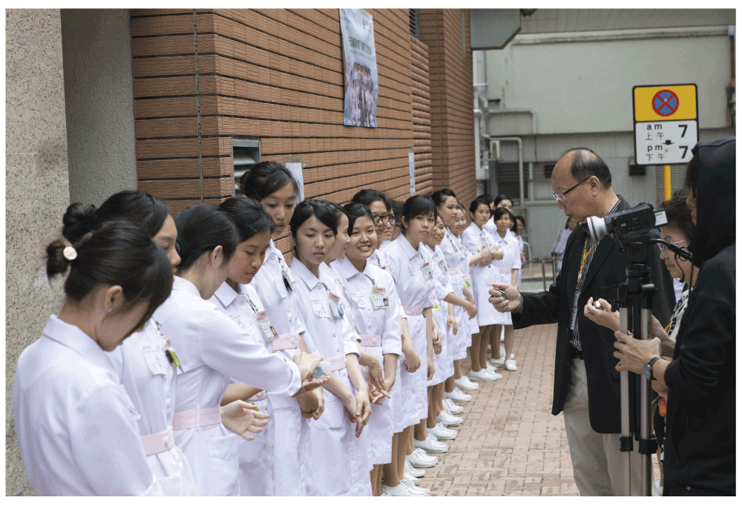
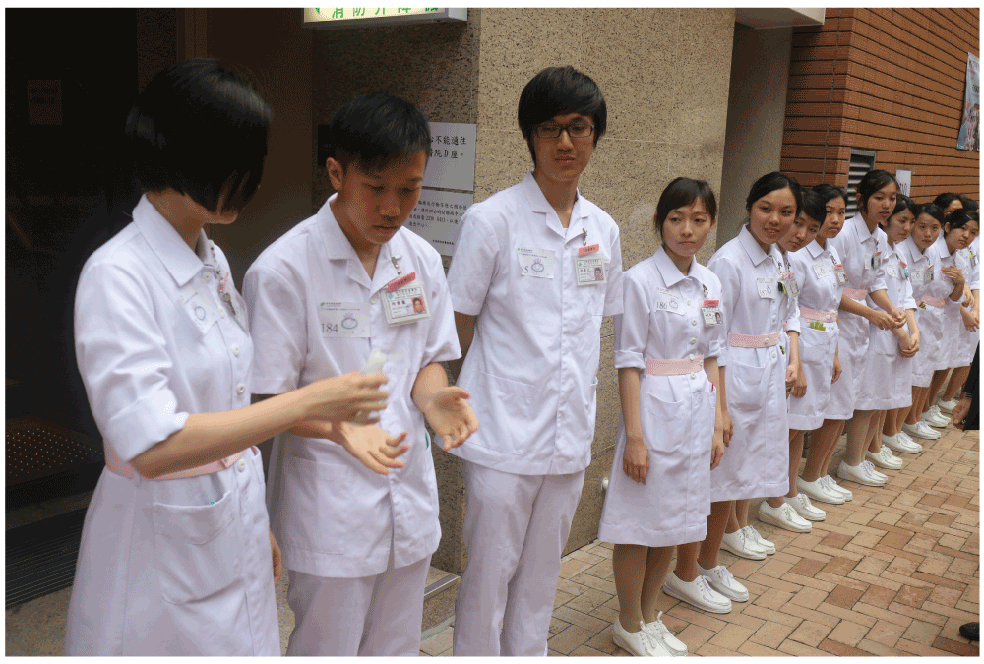
Background
Over the past 20 years, the WHO have promoted hand-washing as the cure-all for HAI.
In HK hospitals, workers are constantly reminded to wash their hands !!!
Nurses relay, the first nurse has just performed hand hygiene and is pouring the alcohol rub for the next person
Row of nurses in relay before officials, with their stop-watches and the video camera
3

Slide 4
WHO Safe Hands Campaign
3a

Slide 5
WHO Safe Hands Campaign
Hand-washing Protocol
After Touching Patient
Before Clean/ Aseptic Procedures
After Body Fluid Exposure
Before touching Patient
After Touching Patients Surroundings
3b

Slide 6
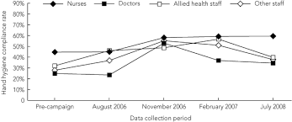
Problem
Although hand-washing is generally adopted world-wide, HAI have not been significantly reduced.
Hand-washing is time consuming and must be repeated each and every time surfaces are touched
Simply is not done – the compliance rate is 30-60%
What this means is hand-washing itself is the most likely
reason HAI are not reduced →
Is there an alternative to hand-washing ?
4

Slide 7
Proposal
QED induced EM radiation from NPs molded into disposable gloves is proposed to disinfect HAI
QED = quantum electrodynamics
EM = electromagnetic
NPs = nanoparticles.
QED disinfection differs from microbial disinfection requiring contact of the HAI with the NP
QED induces UVC radiation from NPs in the glove upon absorbing body heat from the fingers disinfecting HAI at a distance
5

Slide 8
Preface
It may appear absurd that HAI can be disinfected with UVC produced from Body Heat
But is not absurd because of QM
QM = quantum mechanics.
6

Slide 9
Principle of Operation
By QM, atoms in NPs do not have the heat capacity to conserve body heat by an increase in temperature.
Instead, QED conserves body heat by creating UVC radiation inside the NP
For refractive index n and diameter d
λ = 2 nd
ZnO → n = 2.5, d → 50 nm
UVC → λ ≅ 254 nm
7

Slide 10
Theory
Heat Capacity of the Atom
Conservation of Energy
EM Confinement
8

Slide 11
Heat Capacity of the Atom
Classical Physics (MD, Comsol)
Classical Physics (MD, Comsol)
kT 0.0258 eV
QM
(kT = 0)
Nanoscale
Macroscale
In NPs, the atom has no heat capacity
9

Slide 12
Conservation of Energy
Without heat capacity, how do NPs conserve energy?
Proposal
Absorbed EM energy is conserved by creating QED radiation inside the NP - by frequency up - conversion to its EM resonance
10

Slide 13
High EM Confinement?
NPs have high surface-to-volume ratios →
All energy into surface → interior atoms under high EM confinement, but QM precludes temperature increase.
QED converts the trapped energy into standing EM radiation in the UVC that disinfects the HAI
QED → f = ( c/n) / λ λ / 2 = d E = h f
Glove
Body Heat
Glove
UVC
NP
Finger
No
Temperature
Increase
HAI
Standing
Wave
11

Slide 14
Implementation
QED Disinfection Protocol
Body Heat
Available UVC Dosage
UVC Disinfection Dosage
12

Slide 15
QED Protocol
The HAI disinfection protocol assumes:
The QED glove acquires HAI upon touching a surface.
The UVC dosage D required to disinfect the HAI depends on the time τ between touching the surface and the patient
D = Q τ
Q = Body Heat
13

Slide 16
Body Heat
Total human body power is about 100 W.
Since the average surface area for adult men and women is about 1.75 m², the body heat Q is,
Q ∼ 60 W/m² = 6 mW/cm²
14

Slide 17
Available UVC Dosage
For Body Heat
Q = 6 mW/cm² = 6,000 μW / cm²
D = Q τ
For τ = 10 s →
D = 60,000 μW - s / cm²
15

Slide 18
UVC Disinfection Dosage
Back to Question in preface,
Can Body Heat disinfect HAI?
16

Slide 19
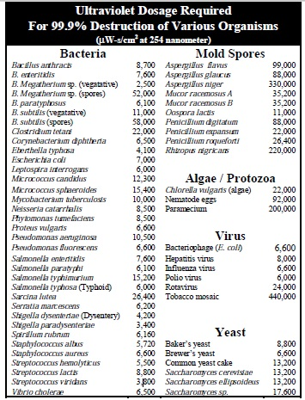
For τ = 10 s → 60,000 μW-s / cm²
Disinfects:
All Bacteria / Yeast
and
Most Spores / Virus
Except
as noted
17

Slide 20
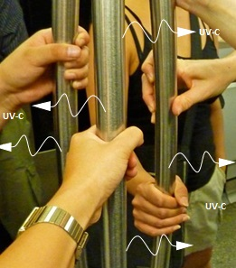
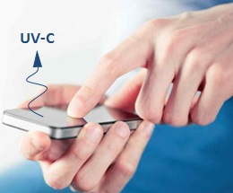
Extensions
QED radiation beyond HAI are diverse
Fourth mode of heat transfer
Discrete MD simulations
Shock wave
Nanotube pressure
etc
Disinfection Applications
(50 nm ZnO Coating)
Public Transportation
Smart Phones
West Africa – Ebola and Drinking Water
18

Slide 21
Ebola and Drinking Water
QED induced UVC radiation from body heat in hand-held nano-coated bowls disinfects without electricity.
Applicable to West Africa
No electricity, but body heat available !!!
19

Slide 22
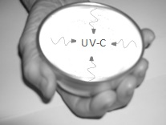
Protocols
Q ∼ 6,000 μW/cm²
Ebola
Disinfection 400 μW-s/cm²
Move bowl over surface in < 1 s scans
Drinking water
Disinfection 38,000 μW-s/cm²
Hold water in bowl for at least 7 s
20

Slide 23
Hand Washing
Washing hands with water only –no soap !
Hold fingers in drinking bowl for 10 s
After meals, use "finger bowls" with water to wash your fingers
Otherwise, you go to washing sink to wash your fingers.
21

Slide 24
Modifications
Longevity - 50 nm ZnO nanocoatings can rub-off in cleaning as in West Africa
Solution - Mold 50 nm ZnO NPs into 100 micron teflon thick coated bowls as in teflon coated pans
Similar to UVC disposable gloves
22

Slide 25
Conclusion
Disinfection by QED induced UVC radiation offers great promise, but collaboration is solicited for development and testing
23

Slide 26
Questions & Papers
Email: nanoqed@gmail.com
http://www.nanoqed.org
24
Notes:
Enter speaker notes here.

