Slide 1
QED Heat Transfer
Thomas Prevenslik
QED Radiations
Discovery Bay, Hong Kong
1
Notes:
Enter speaker notes here.

Slide 2
Heat Transfer
By classical physics, heat transfer proceeds by 3 modes:
Conduction Radiation Convection
Proposal
The Fourth Mode is QED
QED = Quantum Electrodynamics
Here, QED is a simplified form of the complex light and matter interaction advanced by Feynman and others
2

Slide 3

QED Heat Transfer
At the nanoscale, QED converts heat Q into EM radiation because QM precludes conservation by an increase in temperature.
EM = Electromagnetic
QM = Quantum Mechanics
Heat into nanoscale QM box goes into surface → QED radiation
f = (c/n)/λ λ / 2 = d E = h f
d
Heat
Q
QED
Radiation
λ/2 = d
d
λ/2
3

Slide 4
Particles
D < 100 nm
QED
Radiation
D > 1 µm
Temperature
increase
Natural
Convection
Heat
Heat
No
Temperature
Increase
Nanoparticles conserve heat by producing QED radiation
4

Slide 5
Nanocoatings
Natural convection
QED Radiation
Macro Coating > 1 micron Temperature increase
Nano Coating < 100 nm
No temperature increase
Substrate
Heat
Nanocoatings conserve heat by producing QED radiation that enhances heat transfer
5

Slide 6
Theory
Heat Capacity of the Atom
EM Confinement
QED Emission
6

Slide 7

Heat Capacity of the Atom
Classical Physics (MD, Comsol)
Classical Physics (MD, Comsol)
kT 0.0258 eV
QM
(kT = 0)
Nanoscale
Macroscale
1912 → Debye’s phonons → hυ = kT → valid for λ > 100 μm
But, phonons used used in nanostructures !
1900 → Planck derived the QM law
1950 → Teller & Metropolis MD → PBC → valid for λ > 100 μm
Today, MD used in discrete nanostructures !
How do nanostrucures provide high EM confinement?
7

Slide 8
EM Confinement
Nano structures have high surface-to -volume ratio.
Surface heat places atoms under high EM confinement.
But QM precludes temperature increase.
QED conserves the trapped energy to EM radiation.
Nano
Coating
Heat
QED
Radiation
QED
Radiation
QED
Radiation
Heat
Body
No
Temperature
increase
Surroundings
QED
d = λ/2
QED → 100 % efficiency >> LEDs !!!
LED = Light emitting diodes
8

Slide 9
QED Emission
YSZ
ZnO
λ = 2 nd
9

Slide 10
Applications
Thin Films
Turbine Blades
EUV Lithography
Shock Waves
High Pressure Chemistry
Near Field Enhancement
Superlens
Water Disinfection
Cosmology by Cosmic Dust
Exoplanets
ISM Infrared Spectra
10

Slide 11
Thin Films
Cooling by QED radiation in thin films began 50 years ago
Data shows conductivity is reduced with film thickness
QED radiation was not included in the heat balance.
Exclusion of QED radiation from the heat balance is understandable as the UV would normally not be observed
11

Slide 12
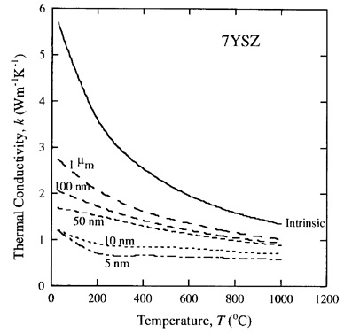
Turbine Blades
Gas turbine blades are coated with TBC comprising nano grains to insulate the blade from hot combustor gases.
TBC = thermal boundary coating.
Nano coatings do not insulate the blade from high temperature, but radiate the heat to the surroundings
Reductions in thermal conductivity with nano grains is based on phonon scattering analysis ?
Turbine blade QED coatings differ from those in nanoelectronics because it is difficult, if not impossible to keep the coatings clean from fouling by combustor gas residues.
12

Slide 13
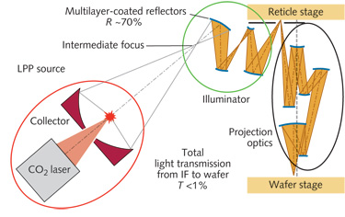
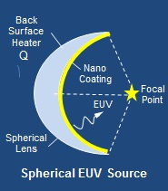
EUV Lithography
Difficulty in Moore’s law at 13.5 nm is LPP lithography.
LPP = laser produced plasma
Based on classical physics, LPP requires high temperature → EUV light using CO₂ lasers focused by large mirrors
QED lithography is far simpler
QED uses a small spherical glass lens provided on the front surface with a nanoscale ZnO coating to convert heat into a EUV light source. Lasers are not required.
QED radiation λ = 2 n d
For ZnO coating n = 2.5 → d < 3 nm is in the EUV having wavelengths < 15 nm.
EUV Coherency depends thickness control
13

Slide 14
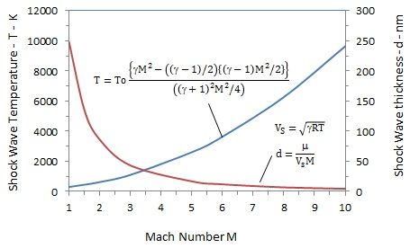
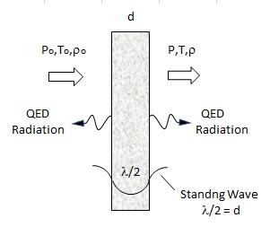
Shock Waves
Shock waves are thought to heat gases from 1000 to 10,000 K and to study gas molecules at high temperatures
Temperatures are calculated because measurements can not be made in the infinitesimally thin shock thickness.
Today, high temperatures of gas molecules are calculated from spectroscopic frequency measurements
QED differs
QED radiation is emitted from shock thickness
Shock wave thickness inferred from half-UV wavelength measurements
14

Slide 15
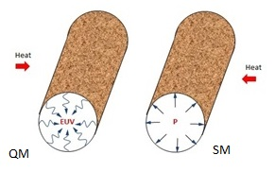

High Pressure Chemistry
MD simulations show very high pressures - tens of thousands of atmospheres - are produced in nanotubes even if the ends are open to atmospheric pressure!!!
$$P=kT\left[ρ−\frac{1}{V}ln〈exp\left(−\frac{ΔU}{kT}\right)〉\right]$$
By QM, atoms in nanopores under high EM confinement have vanishing kT heat capacity → pressure P to vanish.
Enhanced chemistry in nanotubes is caused by EUV radiation.
15

Slide 16
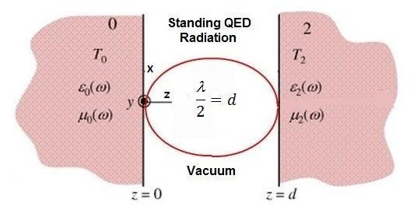
Near Field Enhancement
MIT mathematicians claim that if the bodies are separated by nanoscale gaps, say < 100 nm, the amount of heat transmitted exceeds the blackbody limit by 100 to 1000 times.
However, QM requires denies atoms under EM confinement in surfaces of nanoscale gaps the heat capacity to change in temperature to propagate thermally excited evanescent waves
Hence, near field enhancement based on evanescent waves to carry NIR heat across the nanoscale gaps does not occur.
Instead, QED tunnels heat across the gap, but does not enhance the heat transfer above the blackbody limit
16

Slide 17
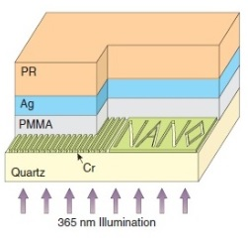
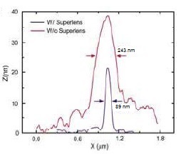
Superlens by QED
Optical image quality depends on the diffraction limit.
But a superlens can restore images below the diffraction limit.
PMMA under UV illumination at λ = 365 nm has a diffraction limited wavelength P* = λ / n = 365/1.5 = 243 nm
Add 35 nm silver film gives P* = 89 nm < 243 nm ?
Currently, evanescent waves and negative permittivity are thought to explain enhanced image quality, but evanescent
cannot exist by QM
By QED, the P* 243 nm image is conserved by creating EM radiation at P* = 2 nd = 2*1.28*35 = 89.6 nm
17

Slide 18
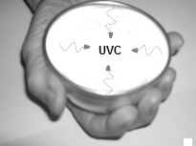
Water Disinfection
Hand-held bowls are provided with nanoscale ZnO coatings to produce UVC from body heat and disinfect drinking water
No electricity – West Africa
LEDs in the UVC are thought to provide the future disinfection of drinking water. But LEDs require electricity and cannot achieve the 100% efficiency of QED disinfection.
Similar to nano-coated Turbine Blades, nano coatings on drinking bowls are likely to rub off in cleaning. Molding 50 nm ZnO NPs dispersed in a 100 micron teflon-composite is suggested.
TBC on Turbine Blades ?
18

Slide 19
Cosmology by Cosmic Dust
In 1929, Hubble formulated the law based on Doppler’s Effect that the velocity of a galaxy is proportional to its distance to the Earth.
However, cosmic dust comprising silicates permeate space and also is proportional its distance from Earth.
If galaxy light is redshift upon absorption in dust, velocity measurements of galaxies requires correction
Cosmic dust
Z Hubble = Z meas – ( Z Lyα - Z Hα )
Redshift
Galaxy
Light
λo = 2 nd
Galaxy
Light
λ
d
Redshift in dust means the Universe need not be expanding → no dark matter and energy
Z = ( λo - λ ) / λ
19

Slide 20
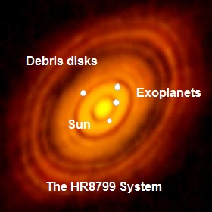
Exoplanets
Discovery of exoplanets in far reaches of galactic space requires high-precision spectroscopy because of faint images as the planet spins.
IR spectroscopic measurements of the suspected exoplanets identified ammonia from 1450 to 1550 nm observed for planets in our solar system.
However, Lyα photons may be redshift in cosmic dust of the debris of planets spinning away from us QED wavelength λ_{o} = (Z+1) to IR wavelengths λ = 1500 nm.
Hence, redshifted Lyα radiation in dust to NIR could be interpreted as proof of ammonia discovery - when in fact the exoplanet may not even exist.
In a spinning exoplanet, half of the planet rotates away from Earth, while the other half toward Earth. The spectrum of the side spinning away shows redshift while the side spinning toward us shows blueshift.
20

Slide 21
ISM IR Spectra
Cosmic dust is thought to emit thermal EM radiation from NIR to IR wavelengths from non-equilibrium heating by single Lyα photons.
However, the notion that cosmic dust heats-up upon absorption of single Lyα photons is based on classical physics that allows the atom to have heat capacity.
QM denies cosmic dust under EM confinement the heat capacity to conserve the absorbed Lyα photon by a spike in temperature. Instead, QED produces IR in the ISM by redshift of Lyα photons as described for exoplanets without increasing temperature.
21

Slide 22
QM in Nanotechnology
Nanoparticle Combustion
22

Slide 23
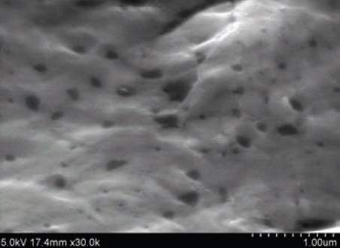
NP Combustion
Add carbon NPs to a molten aluminum in air ( 0xygen ), cool to ambient and take SEM micrographs
Carbon NPs did not combust at 600 C?
C + O² → CO²
Repeat for micron size porous carbon,
Carbon NPs not found in SEM → Complete NP combustion ?
Tensile tests show NPs enhance properties →
Carbon enhances aluminum bond ? DFT disproved
QM Interpretation: NPs do not have heat capacity
Macro carbon increases in temperature. NPs remaining after combustion stay at high temperature and also combust.
Temperature changes do not occur in NPs
23

Slide 24
Conclusions
QED is the Fourth Mode of Heat Transfer
But only in nanostructures with short EM wavelength confinement !!!
Long wavelength EM confinement at the macroscale → conservation of heat by temperature changes
24

Slide 25
Questions & Papers
Email: nanoqed@gmail.com
http://www.nanoqed.org
25
Notes:
Enter speaker notes here.

