Slide 1
QED: The Fourth Mode of Heat Transfer
Thomas Prevenslik
QED Radiations
Discovery Bay, Hong Kong
1
Notes:
Enter speaker notes here.

Slide 2
Heat Transfer
By classical physics, heat transfer proceeds by 3 modes:
Conduction
Radiation
Convection
Proposal
QED is the Fourth Mode of Heat Transfer
QED = Quantum Electrodynamics
Interaction of light and matter - Feynmann
QED is simplified
2

Slide 3
Definition
Scope
Heat transfer by classical physics applies to the macroscale.
The Fourth mode is applicable to nanostructures
But in this talk, nanocoatings on macroscopic bodies
At the nanoscale, QED converts heat into EM radiation because QM precludes conservation of the heat by an increase in temperature.
EM = Electromagnetic
QM = Quantum Mechanics
3

Slide 4
4th Mode of Heat Transfer
Natural convection
QED Radiation
Macro Coating > 1 micron Temperature increase
Nano Coating < 100 nm
No temperature increase
Substrate
Heat
Nano Coatings conserve body heat without temperature increase as QED radiation bypasses natural convection to enhance heat transfer
4

Slide 5
Theory
Heat Capacity of the Atom
EM Confinement
5

Slide 6
Heat Capacity of the Atom
Classical Physics (MD, Comsol)
Classical Physics (MD, Comsol)
kT 0.0258 eV
QM
(kT = 0)
Nanoscale
Macroscale
1912 → Debye’s phonons → hυ = kT → valid for λ > 100 μm
Today, phonons used in nanostructures !
1900 → Planck derived the QM law
1950 → Teller & Metropolis MD → PBC → valid for λ > 100 μm
Today, MD used in discrete nanostructures !
In nano coatings, the atom has no heat capacity by QM
6

Slide 7
EM Confinement
Nano structures have high surface-to -volume ratio.
Surface absorption places interior atoms under high EM confinement, but QM precludes temperature increase.
QED conserves the trapped energy to EM radiation.
QED: Simplified Definition
EM energy into QM box → Create QED radiation at λ/2 = d
f = (c/n)/λ λ = 2d E = h f
Nano
Coating
Heat
QED
Radiation
QED
Radiation
QED
Radiation
Heat
Body
No
Temperature
increase
Surroundings
QED
d = λ/2
QED → 100 % efficiency >> LEDs !!!
LED = Light emitting diodes
7

Slide 8
Applications
Thin Films
Nanoelectronics
Turbine Blades
EUV Lithography
Disinfection
8

Slide 9
Disinfection
Hand-held bowls are provided with nanoscale ZnO coatings to produce UVC from body heat and disinfect Ebola and drinking water
No electricity – West Africa
LEDs in the UVC are thought to provide the future disinfection of drinking water. But LEDs require electricity and cannot achieve the 100% efficiency of QED disinfection.
9

Slide 10
Body Heat
Total human body power is about 100 W.
Since the average surface area for adult men and women is about 1.75 m², the body heat Q is,
Q ∼ 60 W/m² = 6 mW/cm² = 6,000 μW / cm²
10

Slide 11
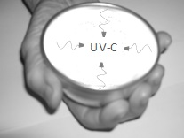
Protocols
Q ∼ 6,000 μW/cm²
Ebola
Disinfection 400 μW-s/cm²
Move bowl over surface in < 1 s scans
Drinking water
Disinfection 38,000 μW-s/cm²
Hold water in bowl for at least 7 s
11

Slide 12
Modifications
Longevity - 50 nm ZnO nanocoatings can rub-off in cleaning as in West Africa
Solution - Mold 50 nm ZnO NPs into 100 micron teflon thick coated bowls (as in teflon coated pans)
12

Slide 13
QM in Nanotechnology
Nanoparticle Combustion
13

Slide 14
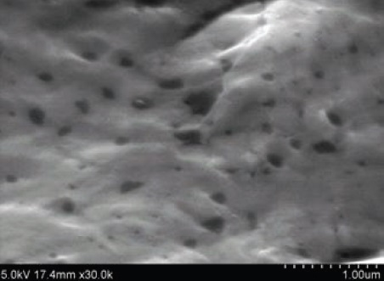
NP Combustion
Add carbon NPs to a molten aluminum in air ( 0xygen ), cool to ambient and take SEM micrographs
Carbon NPs did not combust at 600 C?
C + O² → CO²
Repeat for micron size porous carbon,
Carbon NPs not found in SEM → Complete NP combustion ?
Tensile tests show NPs enhance properties →
Carbon enhances aluminum bond ? DFT disproved
QM Interpretation: NPs do not have heat capacity
Macro carbon increases in temperature. NPs remaining after combustion stay at high temperature and also combust.
Temperature changes do not occur in NPs
14

Slide 15
Conclusion
QED is the Fourth Mode of Heat Transfer
But only in nanostructures !!!
EM confinement at the macroscale cannot create short wavelength QED radiation
15

Slide 16
Questions & Papers
Email: nanoqed@gmail.com
http://www.nanoqed.org
16
Notes:
Enter speaker notes here.

