Slide 1
Nanocomposites by Quantum Mechanics
Thomas Prevenslik
QED Radiations
Discovery Bay, Hong Kong
1
Notes:
Enter speaker notes here.

Slide 2
Introduction
Nanocomposites with uniform dispersion of NPs avoid agglomeration to significantly enhance mechanical properties.
NPs = Nanoparticles.
How can uniform dispersion of NPs be achieved?
Fabricate large numbers of metal NPs enclosed in a PP shell of nanoscale thickness. Upon thermal processing in a 3D mold, the PP shells melt to form a uniform NP spacing
.
Mold
NP
PP
Shell
2

Slide 3
Enhanced Mechanical Properties
Charge uniform NP dispersion ?
+
+
+
$$F_{c}=\frac{q^{2}}{4πε_{0}κδ^{2}}$$
δ = spacing
+
+
+
+
δ
+
+
+
+
+
+
+
+
Coulomb Repulsion between NPs → Triaxial Stress State
Enhanced Elastic Modulus
But what if NP charges decay?
3

Slide 4
Electrets
Electrets are dielectric materials having a quasi-permanent electric charge
High resistance of electrets allow charge to not decay for a hundred years!
Electrets are made from synthetic polymers
Fluoropolymers
Teflon, Polypropylene(PP), etc.
4

Slide 5
Charging Mechanism
Manufactured by cooling after melting in a strong electric field
QED Charging by QM
QED = quantum electrodynamics
QM = quantum mechanics
5

Slide 6
QED Charging
.
In classical physics, the NP atoms have heat capacity allowing atoms to increase in temperature during thermal processing, but not by QM
By the Planck law, the NP atoms are precluded from having the heat capacity to increase in temperature.
Instead, conservation of heat in thermal processing proceeds by QED inducing the NPs to create non-thermal EM radiation
QED = simple quantum electrodynamics
EM = electromagnetic.
6

Slide 7
Photoelectric Effect
QED induced EM radiation ionizes the metal NP removing electrons leaving positive charged NPs
EM radiation at λ =200 nm → E = hc/ λ → 6.21 eV
The EM radiation wavelength λ = 2 nd, where n and d are the refractive index and diameter of the NP.
For Fe NPs, n = 1.5 and d ≅ 70 nm →
NPs are charged
7

Slide 8
Theory
Heat Capacity of the Atom
Conservation of Energy
EM Confinement
8

Slide 9
Heat Capacity of the Atom
Classical Physics (MD, Comsol)
Classical Physics (MD, Comsol)
kT 0.0258 eV
QM
(kT = 0)
Nanoscale
Macroscale
1912 → Debye’s phonons → hυ = kT → valid for λ > 100 μm
But, phonons used used in nanostructures !
1900 → Planck derived the QM law
1950 → Teller & Metropolis MD → PBC → valid for λ > 100 μm
Today, MD used in discrete nanostructures !
How do nanostrucures provide high EM confinement?
9

Slide 10
Conservation of Energy
At the nanoscale, QED converts heat Q into EM radiation because QM precludes conservation by an increase in temperature.
QED is a simple form of the complex light and matter interaction advanced by Feynman and others
Heat → QM box w/o heat capacity → QED radiation
f = (c/n)/λ λ / 2 = d E = h f
d
Heat
Q
QED
Radiation
λ/2 = d
d
λ/2
10

Slide 11
EM Confinement
NPs have high surface-to-volume ratios →
All heat into surface → surface atoms under high EM confinement, but QM precludes temperature increase.
QED converts the surface energy from thermal processing into standing EUV radiation that ionizes the Fe NPs
Glove
+
+
+
No
Temperature
Increase
electron
+
EUV
Standing
Wave
+
+
+
+
+
+
+
+
+
+
+
+
11

Slide 12
Purpose
MD simulations are presented to show significant stiffening by triaxial stress states using a nanoscale tensile specimen of PP including 500 - iron NPs on a spacing of 500 nm
MD = molecular dynamics
12

Slide 13
MD Simulation
Simplification
Model
Analysis
Results
13

Slide 14
Simplification
In the Fe – PP composite, MD simulations usually consider all atoms
The MD here differs - only Fe NPs are simulated for simplicity as the PP continuum is insignificant
14

Slide 15
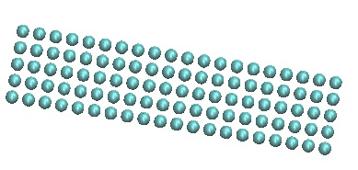
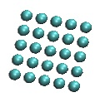
Model
.
MD simulations of 500 nm spacing used a specimen having sides w = 2000 nm and length L = 10,000 nm comprising 500 NPs in a BCC configuration
y
Support
z
F
w
x
w
z
Boundary Conditions
At Z = 0, UZ = 0
PP constrains NPs to move only in Z direction
UX = UY = 0
Displacement Loading
At Z= L, UZ = Δ
$F=(w^{2}E/L$) Δ
15

Slide 16
Lateral Constraint
Coulomb repulsion $F_{c}$ force
$$F_{c}=\frac{q^{2}}{4πε_{0}κδ^{2}}$$
= dielectric constant
PP → κ = 1.5 → $F_{c}=6.13x{10}^{−16}N$
$$F_{E}$$
= 500 nm
$E=130 MPa$
$$F_{E}=65  N$$
$=9.4x{10}^{−18}$ m !
Δ << δ
δ
Δ
$$F_{E}=E $$
δ
δ
PP constrains Fe NPs to only move in Z - direction
16

Slide 17
Results
$$E_{120}=E_{100}{\left(\frac{100}{120}\right)}^{3}$$
$$E=\frac{nq^{2}}{4πε_{0}κΔ}\frac{1}{δ^{3}}$$
16

Slide 18
PP Results
$$E_{δ}=E_{100}{\left(\frac{100}{δ}\right)}^{3}$$
At 1000 - nm, the enhancement is about 2 times
For a 500 nm NP spacing, the Young’s modulus of PP is enhanced 10 times
17

Slide 19
Conclusions
MD based on classical physics that assumes NP atoms have kT energy is invalid for nanocomposites
MD based on QM requires heat during thermal processing to be conserved by QED inducing EM radiation that charges the metal NPs to produce Coulomb repulsion and a triaxial stress state to enhance the Young’s modulus of PP
But,
Whether the very large number of NPs can be economically produced is an open question !
19

Slide 20
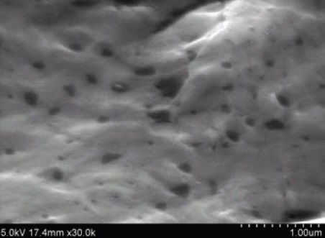
NP Temperature
Carbon NPs did not combust at 600 C?
C + O2 → CO2
Repeat for micron size carbon,
Carbon NPs not found in SEM → Complete NP combustion ?
QM Interpretation: NPs do not have heat capacity
Macro carbon increases in temperature
Combustion reduces macro carbon to NP size
NPs stay at high temperature also combust.
Temperature changes do not occur in NPs!!!
Add carbon NPs to a molten aluminum in air ( oxygen ), cool to ambient and take SEM micrographs
20

Slide 21
Questions & Papers
Email: nanoqed@gmail.com
http://www.nanoqed.org
21
Notes:
Enter speaker notes here.

