Slide 1
Invalidity of Thermal Fluctuations at the Nanoscale
Thomas Prevenslik
QED Radiations
Discovery Bay, Hong Kong
1
Notes:
Enter speaker notes here.

Slide 2
Introduction
Thermal fluctuations and evanescent waves
in electrodynamics based on the FDT are valid for macroscopic structures
FDT = fluctuation dissipation theorem
However, at the nanoscale
Is the FDT valid ?
2

Slide 3
Argument
The Planck law of QM precludes temperature fluctuations in nanoscale films because the heat capacity of the atom vanishes.
QM = quantum mechanics
Evanescent waves requiring a thermal origin are therefore also precluded at the nanoscale
The FDT is invalid at the nanoscale
3

Slide 4
Planck Law of QM
$$E=\frac{\frac{hc}{λ}}{exp\left(\frac{hc}{λkT}\right)−1}$$
At macroscale λ > 100 microns, atoms have kT energy
For λ < 100 microns, kT energy decreases
Nanoscale λ < 0.1 micron, the kT energy vanishes
4

Slide 5
Classical FDT limit
The FDT is usually described* in relation to the classical limit.
hυ << kT or hc/λ << kT
λ >> hc/kT
At 300 K, λ >> 48 microns
The classical limit of the Planck law as h → 0
$\lim_{h→0}{\frac{\frac{hc}{λ}}{e^{\frac{hc}{λkT −1}}}}$ $$ kT
* A. Taflove, et al., Advances in FDTD Computational Electrodynamics, Artech House, 2013, pp. 93
5

Slide 6
FDT
The FDT states any process that dissipates energy by conversion into heat there is a fluctuation that converts the corresponding temperature fluctuations into thermal radiation.
Temperature
Fluctuations
Thermal
Radiation
Energy
Heat
Athermal Systems ?
Independent of temperature - Granular
Temperature
Fluctuations
Thermal
Radiation
Energy
Heat
6

Slide 7
Athermal Systems
Granular materials aside, athermal systems make the heat capacity of a material vanish, say by operation at a temperature of absolute zero.
Athermal conditions at the nanoscale occur under EM confinement in liquid flow through physical channels.
d
N(hc/λo) →
→ N(hc/λo)
E = hc/2d = N(hc/λo) > 5 eV
Charge / Recombine
N = λo / 2d
N = 1 micron/2(50) nm ≅ 10
Inside channel
Standing wave
λ/2 = d
E = hc/2d
7

Slide 8
Natural Athermal Systems
Without physical walls, EM confinement of atoms in nanostructures occurs naturally because of high S/V ratios as any heat absorbed is almost totally deposited in the surface.
S/V = surface-to-volume
Since thermal expansion does not occur, the heat acts as a potential barrier to provide the EM confinement for:
(1) Heat capacity of internal atoms to vanish, and
(2) the boundary for creating standing waves
The process called simple QED
8

Slide 9
Simple QED
Simple QED is a quantum state depending on the dimensions of the nanostructure
Under the QM restriction that the heat capacity of the atom vanishes, the heat Q absorbed in the nanostructure surface creates standing EM radiation having half wavelength λ/2 = d, where d is the minimum dimension of the nanostructure
EM
Radiation
λ = 2nd
Heat
Q
λ/2
High S/V ratios
No
Temperature
Change
f = (c/n)/λ λ / 2 = d E = h f
9

Slide 10
Simple QED - States
Simple QED is observed in the absorption and emission spectra of nanostructures, e.g., NPs and bare atoms having dimensions < 100 nm.
Simple QED excites higher frequencies than the QM states of atoms and molecules
(1) NPs excited in EUV
(2) Bare atoms excited in X-ray range
10

Slide 11
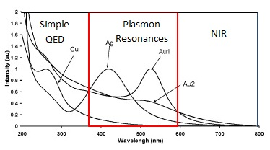
Simple QED - NPs
λ = 2nd
Simple QED state in EUV
excites QM states by fluorescence
Plasmon resonances not directly excited
Simple QED induced fluorescence
11

Slide 12
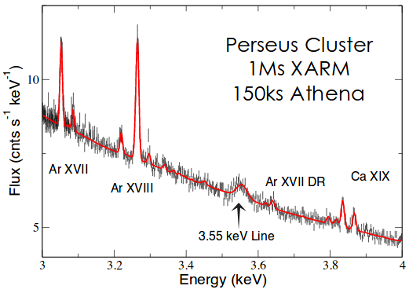
Simple QED – Bare atoms
λ = 2nd
Perseus 3.5 keV X-rays from Dark Matter ?
No known X-ray line
Cosmic dust NPs + Q → fragment → atoms
Simple QED of bare sulfur atoms: R = 88 pm → 3.5 keV
12

Slide 13
Simple QED: A quantum state without electron energy levels?
The simple QED transition from the ground to higher state is created from heat and depends only on the dimensions of the nanostructure that defines the EM energy of the standing photon
Once the heat is used up in creating the standing photon, the EM confinement vanishes and the photon is emitted.
No electron energy levels !
12a

Slide 14
Validity of FDT
Casimir Force
Transformative Optics
Near field Heat Transfer
Maxwell Solutions
13

Slide 15
Casimir Force
In 1948, Casimir predicted two macroscopic non-magnetic bodies with no net electrical charge can experience an attractive force much stronger than gravity.
In 2017, “The existence of this force is one of the few direct macroscopic manifestations of quantum mechanics” *
Casimir used ZPE and not the FDT for thermal fluctuations, but if ZPE is not physical, the Casimir force does not exist?
Jacobson → General relativity derived from thermodynamics
Therefore
QM invalidates Casimir force as the atoms in the gap surfaces are precluded from thermal fluctuations.
*A. I. Volokitin , Electromagnetic Fluctuations at the Nanoscale, 2017.
14

Slide 16
Transformative Optics
Transformative Optics* theory relies on evanescent waves in meta-materials having negative permittivity in contact with a dielectric with a permittivity of equal and positive sign,
but
cannot explain the enhanced image quality of a silver superlens not only because matched permittivity is not required but because evanescent waves cannot exist in nanoscale films.
*J. Pendry, Controlling Light on the Nanoscale, 2014.
15

Slide 17
Near-Field Heat Transfer
Near-field heat transfer* began 50 years ago on the conjecture BB heat Q is greatest at zero spacing
Based on classical physics, surface temperatures do not change as the gap d vanishes, Q is enhanced ?
QM differs as temperatures cannot fluctuate as atoms in the surfaces have vanishing heat capacity
By QM, near field heat transfer is not enhanced
Thot > Tcold Q ↓
Hot
d < 100 nm
Cold
*C. L. Tien, “Effect of Small spacings on radiative heat transfer between Two Dielectrics,” , ASME Trans., 1967.
16

Slide 18
Maxwell’s Solutions
The QM validity of the FDT in Maxwell’s solutions was questioned because of claims of enhanced heat transfer across nanoscale gaps
The Planck law was used to define the dominant NIR wavelengths of thermal radiation of macroscopic bodies given by Wien’s law, i.e., 3.6 and 14.5 microns for body temperatures of 800 and 200 K.
But the validity of the FDT depends on the wavelengths of EM waves standing across the gap – not macroscopic temperatures of the bodies.
By simple QED, atoms on surfaces of nanoscale gaps between macroscopic bodies lack heat capacity. For standing EM radiation in < 50 nm gaps, the EM confinement λ < 100 nm, the surface atom temperatures do not fluctuate → invalid FDT and Maxwell solutions
M. Pinar Mengüç, “Role of fluctuational electrodynamics in near-field radiative heat transfer,” 2008
17

Slide 19
FDT Analysis
Modifications are suggested to current EM radiation heat transfer consistent with QM.
A first solution including the FDT is obtained for macroscopic regions of the structure, but the FDT is excluded at all nanoscopic entities,
e.g., NPs and surfaces exposed to nanoscale gaps.
The first solution gives the local heat flow into each nanoscopic entity that is specified as an EM radiation input to a second solution, the EM radiation given by simple QED.
The process is repeated until temperatures converge.
18

Slide 20
Questions & Papers
Email: nanoqed@gmail.com
http://www.nanoqed.org
19
Notes:
Enter speaker notes here.

