Slide 1
Light-Matter Interaction in Cosmic Dust
Thomas Prevenslik
QED Radiations
Hong Kong and Berlin
1
Notes:
Enter speaker notes here.

Slide 2
Introduction
In 1926, Hubble’s redshift measurements of light from distant galaxies suggested the Universe was expanding thereby supporting Einstein’s GR theory
GR = general relativity
The expanding Universe was based on velocity measurements of distant galaxies inferred from Doppler redshifts of light
2

Slide 3
Observation
Since Hubble, galaxy velocities from redshift have led science to believe the Universe is expanding and dark matter is necessary to hold galaxy clusters together
GR is questionable, because galaxy velocities from redshift are overstated by cosmic dust
Dark matter is an illusion - not a physical property of the Universe that can be discovered by experiment
Newtonian mechanics governs galaxy dynamics
Proposal
3

Slide 4
QM v. Classical Physics
Classical physics allows atoms in quantum sized cosmic dust particles to fluctuate in temperature
QM forbids temperature fluctuations in cosmic dust
QM = quantum mechanics
QM requires conservation of galaxy photons by non-thermal mechanisms, e.g., the re-emission of redshifted galaxy photons
4

Slide 5
Optical Redshift
Measured redshift
$$Z_{meas}=\frac{Δ}{}=\frac{\left({Δ}_{V}+{Δ}_{D}\right)}{}$$
Δλ_{V} = wavelength increment of galaxy recession
Δλ_{D} = wavelength increment of cosmic dust
Z_{V} = Δλ_{V}/λ recession redshift
Z_{D} = Δλ_{D}/λ cosmic dust redshift
$$Z_{meas}=Z_{V}+Z_{D}$$
5

Slide 6
Doppler Shift
Galaxy velocity measurement
$$\frac{V}{c}=\frac{{\left(Z_{meas}+1\right)}^{2}−1}{{\left(Z_{meas}+1\right)}^{2}+1}$$
For Zmeas << 1,
$$\frac{V}{c}∼ Z_{meas}$$
In, 1970, M31 redshift with NII line at 6583 Å
$Z=\frac{Δλ}{λ}$ ∼ $0.001= \frac{6.583}{6583}$ → V = $3 x {10}^{8}∗0.001=300 km/s$
6

Slide 7
Heat Capacity
$$E=\frac{\frac{hc}{λ}}{exp\left(\frac{hc}{λkT}\right) −1}$$
Classical physics (dotted lines) allows cosmic dust atoms for any EM confinement to always have kT heat capacity.
QM differs by only allowing kT heat capacity at the macroscale
How does cosmic dust provide EM confinement < 0.1 microns?
7

Slide 8
EM Confinement
EM confinement of atoms in cosmic dust is a natural consequence of high S/V ratios of cosmic dust
S/V = surface-to-volume
Upon absorption of galaxy light, almost all of the photon energy is deposited in the dust surface
EM confinement occurs as the dust temperature cannot increase to relieve the surface heat by thermal expansion.
8

Slide 9
Feynman’s QED
The QED of light-matter interaction is usually thought to proceed by the complex relativistic theory based on virtual photons advanced by Feynman and others
QED lacks experimental verification. Even Feynman's argument that light is made of virtual particles is conjecture as only theories of light-matter interaction based on real photons can be verified.
9

Slide 10
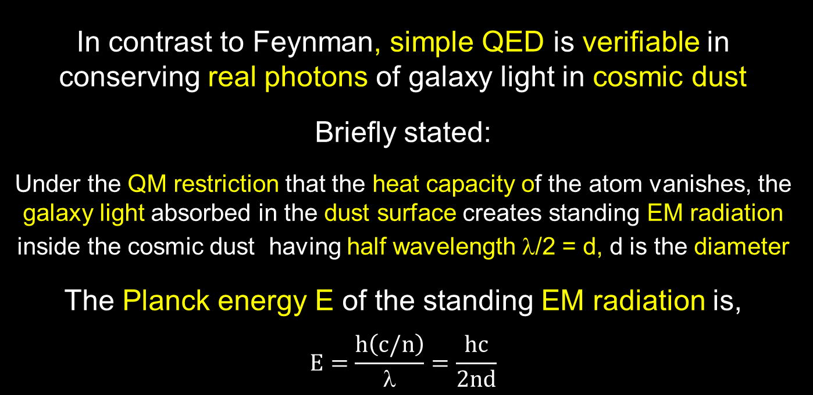
Simple QED
In contrast to Feynman, simple QED is verifiable in conserving real photons of galaxy light in cosmic dust
Briefly stated:
Under the QM restriction that the heat capacity of the atom vanishes, the galaxy light absorbed in the dust surface creates standing EM radiation inside the cosmic dust having half wavelength λ/2 = d, d is the diameter
The Planck energy E of the standing EM radiation is,
$$E=\frac{h\left(c/n\right)}{λ}=\frac{hc}{2nd}$$
10

Slide 11
Summary
Simple QED converts the galaxy photon as a particle to a wave in cosmic dust and back to a redshifted particle
Galaxy Photon → Dust w/o heat capacity → Redshift Photon
Galaxy Photon
(hc/λ)
Redshift
Photon
(hc/2nd)
λ/2
High S/V ratios
No
Temperature
Change
$$Z_{D}=\frac{\left(2nd−λ\right)}{λ}$$
11

Slide 12
Discussions
Accelerating Universe Expansion
Dark Matter
12

Slide 13
Accelerated Expansion
In 2001, SN was found brighter than it should gave been → accelerated Universe expansion.
Redshift Z_{D} > 0 → SN appears further away, Z_{meas} = Z_{V} + Z_{D},
But Brighter because the SN is actually at Z_{V}
Accelerating Universe is not physical, but rather an illusion caused by cosmic dust.
Brightness
O
Z_{V}
SN
Redshift
O
Z_{V}
+ Z_{D}
SN
13

Slide 14
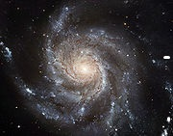
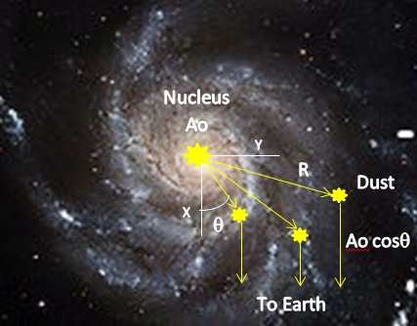
Dark Matter
In 1970’s, Spiral galaxy M31 has a flat velocity curve with a decreasing NII line intensity
V
Z_{D}
Z_{V}
Velocity
$$y=R sin$$
V(y)$=cZ=c\left(2nd−λ\right)$/$$
Flat curve
Line Intensity
$$A=Ao cos$$
Decreasing
Flat curve caused by dust, not dark matter
14

Slide 15
Conclusion
By credibly refuting current cosmology for dark matter and Universe expansion, perhaps cosmology may return to Einstein’s once upon a time static and dynamic Universe.
15

Slide 16
Questions & Papers
Email: nanoqed@gmail.com
http://www.nanoqed.org
16
Notes:
Enter speaker notes here.

