Slide 1
Cosmology and Redshift in Cosmic Dust
Thomas Prevenslik
QED Radiations
Hong Kong and Berlin
1
Notes:
Enter speaker notes here.

Slide 2
Dilemma
Since the 1970's, dark matter is thought to exist because the rotational velocities found in local spiral galaxies (0.001<Z) had the signature of flat rotation curves
Recently, high-redshift (0.6<Z<2.6) galaxies in the distant Universe were found to have falling rotation curves suggesting the absence of dark matter, and
the transparent Ghost galaxy was found to have a falling rotation curve suggesting dust is the source of dark matter
Cosmology faces a dilemma as dark matter should not depend on the transparency of a galaxy or whether a galaxy is in the
local or distant Universe.
2

Slide 3
History
In 1926-9, Hubble discovered the Universe was expanding based on velocity measurements inferred from Doppler redshifts of light from recessing galaxies.
As the galaxy light travels to the Earth especially near galaxies, it interacts with NPs of cosmic dust
NPs = nanoparticles
Astronomers assumed the light-dust interaction followed classical physics causing temperature changes without additional redshift.
But if QM is assumed, the light-dust interaction redshifts the galaxy photon without temperature changes
QM = quantum mechanics
3

Slide 4
Introduction
Dark matter has a long history
In the 1930’s,
1. The Milky Way was found to rotate faster than expected suggesting dark matter was present , and
2. To keep the Coma cluster of galaxies together, the mass of dark matter would have to be much higher than visible matter
Similar to Hubble, early velocity measurements of galaxies were based on redshift of optical wavelengths
4

Slide 5
Introduction (cont’d)
In 1950, the radio astronomers discovered the 21 cm line of neutral hydrogen atoms supported dark matter
In the 1970’s, Rubin & Ford found optical redshifts for the M31 spiral galaxy that suggested dark matter.
Confirmed by 21 cm hydrogen line ?
Scientists generally agree that dark matter is invisible having about 5-times the mass of ordinary matter, but what it is and how it was formed has remained a mystery.
5

Slide 6
QM v. Classical Physics
Classical physics allows atoms in quantum sized dust and hydrogen atoms to fluctuate in temperature
QM forbids temperature fluctuations as atomic heat capacities vanish which requires conservation of galaxy photons by non-thermal mechanisms, e.g.,
Cosmic dust conserves galaxy photons by redshifted optical re-emission.
2. Hydrogen atoms conserve galaxy photons by optical re-emission of the 21 cm hydrogen line.
Both require optical telescopes.
But 21 cm lines measured with radio telescopes only measure temperature fluctuations!!!
6

Slide 7
Proposal
Dark matter is not a physical property of the Universe that can be discovered by experiment and only exists because optical redshifts are overstated by cosmic dust.
Radio redshifts of the 21 cm hydrogen line depending on temperature are simply problematic as QM precludes temperature changes in free hydrogen atoms.
Suggesting cosmology depends only on optical redshift ?
7

Slide 8
Optical Redshift
Measured redshift
$$Z_{meas}=\frac{Δ}{}=\frac{\left({Δ}_{V}+{Δ}_{D}\right)}{}$$
Δλ_{V} = wavelength increment of galaxy recession
Δλ_{D} = wavelength increment of cosmic dust
Z_{V} = Δλ_{V}/λ recession redshift
Z_{D} = Δλ_{D}/λ cosmic dust redshift
$$Z_{meas}=Z_{V}+Z_{D}$$
8

Slide 9
Doppler Shift
Galaxy velocity measurement
$$\frac{V}{c}=\frac{{\left(Z_{meas}+1\right)}^{2}−1}{{\left(Z_{meas}+1\right)}^{2}+1}$$
For Zmeas << 1,
$\frac{V}{c}∼ Z_{meas}=\frac{Δλ}{λ}$ →
$V  c Z_{meas}$
In 1970, M31 redshift with NII line at 6583 Å
$Z=\frac{Δλ}{λ}$ ∼ $0.001= \frac{6.583}{6583}$ → V = $3 x {10}^{8}∗0.001=300 km/s$
9

Slide 10
Atomic Heat Capacity
$$E=\frac{\frac{hc}{λ}}{exp\left(\frac{hc}{λkT}\right) −1}$$
Classical physics (dotted lines) allows dust atoms for any EM confinement to always have kT heat capacity.
QM differs by only allowing kT heat capacity at macro scale
How does dust provide EM confinement < 0.1 microns?
10

Slide 11
EM Confinement
EM confinement of atoms in cosmic dust is a natural consequence of high S/V ratios
S/V = surface-to-volume
Upon absorption of galaxy light, almost all of the photon energy is deposited in the dust surface
EM confinement occurs as QM precludes a temperature increase to relieve the surface heat by thermal expansion.
11

Slide 12
Simple QED
The QED of light-matter interaction is usually thought to proceed by the complex relativistic theory based on virtual photons advanced by Feynman and others
Simple QED differs: A real photon conserves the heat from absorbed galaxy photons.
In simple QED, photons are real !
Briefly stated:
Under the QM restriction that the heat capacity of the atom vanishes, the heat of galaxy photon absorbed in the dust surface creates standing EM radiation inside the dust having half wavelength λ/2 = d
12

Slide 13
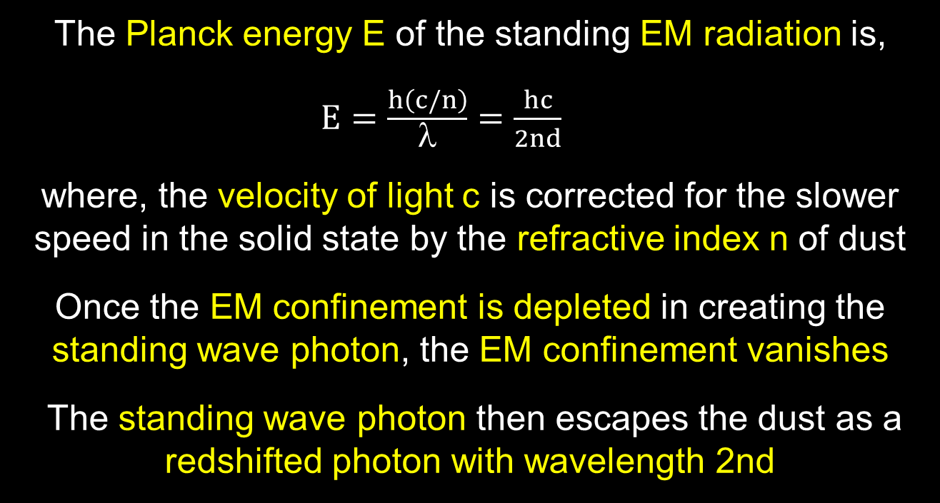
Simple QED(Cont’d)
The Planck energy E of the standing EM radiation is,
$E=\frac{h\left(c/n\right)}{λ}=\frac{hc}{2nd}$
where, the velocity of light c is corrected for the slower speed in the solid state by the refractive index n of dust
Once the EM confinement is depleted in creating the standing wave photon, the EM confinement vanishes
The standing wave photon then escapes the dust as a redshifted photon with wavelength 2nd
13

Slide 14
Valid Redshift?
Ly-α
λ = 0.1217 micron
H-α
λ = 0.656 micron
$Propose :\text{If} ZL_{yα}=ZH_{α}$ → No cosmic dust → valid redshift
Problem: Z is usually only measured for 1 line
If > 1 line, compute average Z, but i$\text{f} not s\text{a}me,$ redshift invalid
14

Slide 15
Simple QED
In NPs, simple QED converts heat Q into EM radiation because QM precludes conservation by temperature.
Simple QED is not the complex light and matter interaction advanced by Feynman and others
Heat → NP(w/o heat capacity) → EM radiation
Simple QED
Radiation
E = hc/2nd
Heat
Q
λ/2
High S/V ratios
→
Surface Heat
EUV Fluorescence
↓
UV
ROS
Plasmons
Nanotechnology Experiments
CW lasers
QM →
No Temperature
Change
Conserved by
Standing Wave
f = (c/n)/λ, λ / 2 = d, E = h f, N = Q / E
15

Slide 16
Discussions
Radio Redshift
Accelerating Universe Expansion
Dark Matter
Ghost Galaxy
Wave-Particle Duality
16

Slide 17
Radio Redshift
The Wouthuysen-Field (W-F) effect couples the spin temperature Ts of the 21 cm line of neutral hydrogen at 1420 MHz to the kinetic temperature Tk
The Planck law invalidates the W-F effect as the kinetic temperature T_{k} cannot fluctuate by QM
The 21 cm hydrogen line can only have a non-thermal origin and therefore radio redshift has no meaning →
Cosmology must rely on optical redshift !!!
17

Slide 18
Accelerated Expansion
In 2001, SN was found brighter than it should have been → accelerated Universe expansion.
Redshift Z_{D} > 0 → SN appears further away, Z_{meas} = Z_{V} + Z_{D},
But Brighter because the SN is actually at Z_{V}
Accelerating Universe is not real, but rather an illusion caused by cosmic dust.
Brightness
O
Z_{V}
SN
Redshift
O
Z_{V}
+ Z_{D}
SN
18

Slide 19
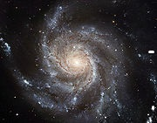
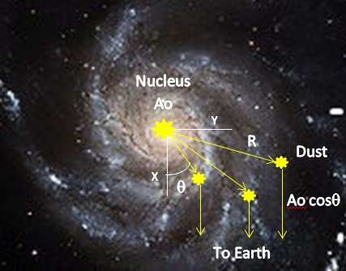
Dark Matter
In 1970’s, Spiral galaxy M31 has a flat velocity curve with a decreasing NII line intensity
V
Z_{D}
Z_{V}
Velocity
V(y)$=cZ=c\left(2nd−λ\right)$/$$
Flat curve
Line Intensity
$$A=Ao cos$$
Decreasing
Flat curve caused by dust, not dark matter
19

Slide 20
Line Intensity
The intensity of the NII line in M31 was found to decrease with galaxy radius.
Since the EM energy of the galaxy photon is absorbed in the NP surface, Fermat’s principle requires the emission to occur in minimum time →
Direction is across the minimum dimension between NP surfaces. For spherical NPs, in the direction of the incoming NII line
For a plate~like NP, normal to the plate surface.
20

Slide 21
Shape Intensity
$$y$$
θ
Line Intensity
$$A=Ao cos $$
NII Line
Line Intensity
$A=Ao cos ($-β)
$$x$$
β
θ - β
$$A$$
Earth
20a

Slide 22
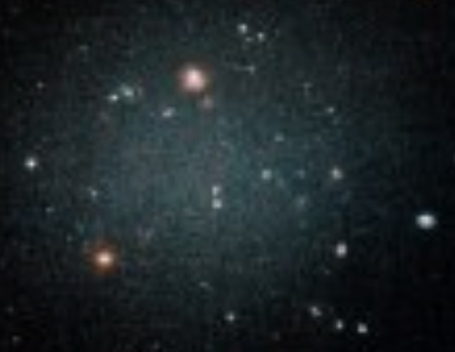
Ghost Galaxy
DF2 Galaxy – No Dark matter
Questions
No dark matter?
Transparent
Can the audience explain?
???
No dark matter because no cosmic dust !!!
21

Slide 23
Wave-Particle Duality
Simple QED is the mechanism by which a photon as a particle becomes a wave depending on interaction with the size of matter
Galaxy Photon
E = hν
Redshift
Photon
E = hν’
Wave
In vacuum, photon is a particle, not a wave
In matter, photon is a wave, not a particle, but
wave depends on the size of matter
22

Slide 24
Conclusion
Because of cosmic dust, perhaps cosmology may return to Einstein’s once upon a time static and dynamic Universe.
23

Slide 25
Questions & Papers
Email: nanoqed@gmail.com
http://www.nanoqed.org
24
Notes:
Enter speaker notes here.

