Slide 1
Neuro-Degenerative Diseases by UV Radiation from Nanoparticles
Thomas Prevenslik
QED Radiations
Hong Kong and Berlin
Notes:
Enter speaker notes here.

Slide 2
Introduction
NDs like autism, Parkinson’s, and Alzheimer’s have unknown origins.
NDs = Neurodegenerative diseases
NDs involve genetic and environment factors
.
Genetic factors are inherited.
Environment factors are fragrances in cosmetics, glyphosate in herbicides, and aluminum adjuvants in vaccines.

Slide 3
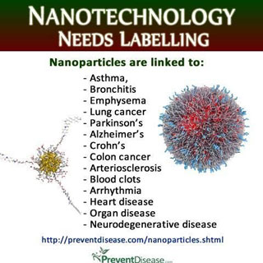
NPs in Nanotechnology
Experiments over 2 decades show adding NPs to biological fluids damage DNA
NPs = Nanoparticles
Protection of consumer health by labeling of products having NPs
Diversity of human health problems suggests genes are scrambled .
NPs are scrambling DNA
How?
UV radiation

Slide 4
DNA Damage(cont’d)
In 2003, NPs were shown to induce oxidative stress, but correlated with large S/V = surface-to-volume ratios.
In 2008, DNA damage was linked to cancer by ROS.
ROS = reactive oxygen species, e.g., OH* radicals
A decade ago, PDT was thought to kill tumors by heating NPs to high temperature → no DNA damage
PDT = photodynamic therapy
But in 2016, PDT with Ag NPs was shown to cause significant DNA damage in lung cancer cells.
Did ROS damage DNA?
NO !!! NPs produced UV that damaged DNA

Slide 5
DNA Damage by UV
To produce UV radiation → E ∼ 5 eV
Source of UV in the human body is not known
But, NPs enter body in GM food and vaccinations
GM = Genetically Modified
Consider: NPs produce EUV !!!
EUV > 20 eV > UV ∼ 5 eV →
EUV fluorescence excites lower NP quantum states, e.g., ROS, UV radiation, plasmon resonances

Slide 6
NPs in Baby Food
Science knew for decades Ag NPs were a disinfectant, but allowed Ag NPs in baby food
Rationale: NPs disinfect bacteria
But what about collateral DNA damage to Babies?
Science is responsible !!!

Slide 7
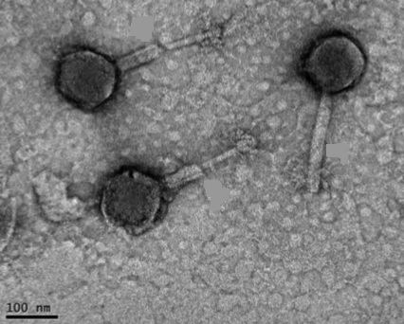
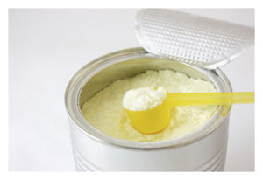
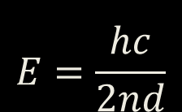
Death from Baby Milk
Danone is looking into reports Aptamil baby milk formula is making infants ill.
UV
100 nm
UV
Deaths caused by bacteria
Cronobacter sakazakii
Add bacteriophages to powder to digest sakazakii DNA
$$E=\frac{hc}{2nd}$$
UV
Metabolism produces UV radiation → inflammation

Slide 8
NPs in GM food
We know solar UV radiation is genotoxic as DNA is damaged that can lead to skin cancer
Since solar UV does not penetrate the skin, we think DNA damage of internal organs by UV cannot occur.
However,
NPs in the ( glyphosate in weed control herbicides) to enhance GM food production also enter the food crop and upon digestion produces UV, the DNA damage may lead to Cancer
The Genotoxicity of GM food?,
BIT’s 8th World Gene Convention – November 13-15, 2017

Slide 9
GM food (cont’d)
To control weeds, Monsanto’s Roundup containing
the herbicide glyphosate is widely sprayed on fields.
Glyphosate does not readily penetrate the leaves of weeds and is mixed with POEA that aids penetration.
POEA = polyoxyethyleneamine
Weeds alone cannot be sprayed and the POEA enters the leaves of contiguous corn and soybean crops as an emulsion of NP globules that finally reside in the plant crop.

Slide 10
GM food (cont’d)
Monsanto claims no NPs in Roundup
But NPs of POEA globules form upon mixing in water.
POEA globules adhere to cell surfaces
Metabolism → Heat → EUV radiation
Leite FL, et al. “Study on the adsorption of poly(o-ethoxyaniline) nanostructured films using atomic force microscopy,” Polymer 46: 12503-12510, 2005

Slide 11
GM food (cont’d)
EUV
EUV
Cell
Heat
POEA
Globule
Ionize
EUV
EUV
DNA
Glyphosate
POEA is genotoxic – not glyphosate
Monsanto statement of no NPs in Roundup is correct,
but toxicity comes in mixing with water

Slide 12
Purpose
Similar to Cancer by NPs in GM food, adjuvants are added to vaccines to stimulate the immune systerm in amplifying response to antigens that are not immunogenic
The purpose here is to show adjuvant NPs in vaccines produce EM radiation that not only excites the antigens to invoke greater immune system response, but also enhances the NDs.
Adjuvants = NPs of aluminum hydroxide

Slide 13
ND Analysis
Causal Relation
The Planck law of QM
Simple QED
Vaccinations – DNA Damage

Slide 14
Causal Relation: NPs → NDs
The DNA may be inherited
or
modified by factors in the environment
DNA is modified by UV radiation produced from NPs in the environment that enter the human body

Slide 15
The Planck law of QM
Classical physics
kT 0.0258 eV
QM
NPs
How do NPs provide high EM confinement?
Under EM confinement at λ < 100 nm, QM requires atoms in NPs to have vanishing heat capacity
High S/V ratios → NPs atoms confined over < 100 nm

Slide 16
Simple QED
In NPs, simple QED converts heat Q into EM radiation because QM precludes conservation by temperature.
Simple QED is not the complex light and matter interaction advanced by Feynman and others
Heat → NP w/o heat capacity → EM radiation
Simple QED
Radiation
E = hc/2nd
Heat
Q
λ/2
EUV Fluorescence
↓
UV
ROS
Plasmon
High S/V ratios
No
Temperature
Change
f = (c/n)/λ, λ / 2 = d, E = h f, N = Q / E

Slide 17
Vaccinations-DNA Damage
UVC → λ = 254 nm
λ = 2nd
DNA Damage
( Pyrimidine dimer damage replication)
d < 80 nm
by EUV fluorescence
NP diameter - d - nm
d ∼ 80 nm

Slide 18
Extensions
DNA Damage at a distance
Alzheimer’s and DNA Damage

Slide 19
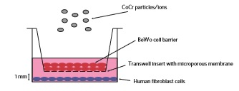
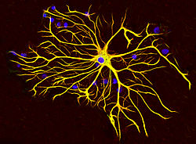
DNA Damage at a Distance
Bristol Experiment (2009)
Astrocyte
The NPs damage DNA .
Signaling molecules transfer DNA damage across cell barrier ?
In 2018, the signaling molecules were claimed to damage DNA, but only when astrocytes were present
Signaling is traditional biology explanation, but simple QED argues the astrocytes most likely produced EM radiation from heat Q from metabolic reactions that damages DNA
*Nanoparticle-induced neuronal toxicity across placental barriers is mediated by autophagy and dependent on astrocytes. ScienceDaily, 4 April 2018.

Slide 20
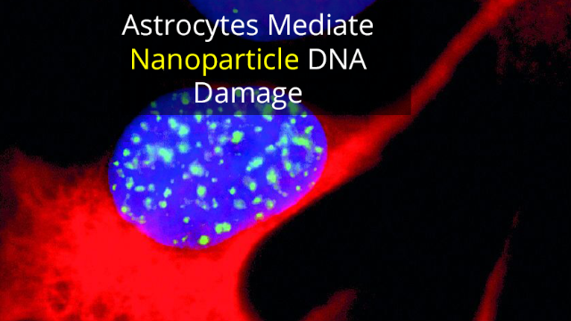
DNA Damage (cont’d)
$$E$$
$$E$$
$$E$$
$E$
$$E$$
d
$$E$$
$$E=\frac{hc}{2nd}$$
$$E$$
Astrocyte - RED
Neuron – Blue
DNA - Green
Astrocyte metabolism → EM radiation depending on diameter d of fibril cross-section. For d = 25 nm and n = 1.41, λ = 2nd = 70.5 nm and E = 18 eV.
UVC at 254 nm having E ∼ 5 eV is excited by 18 eV fluorescence to damage DNA of nearby neuron.

Slide 21
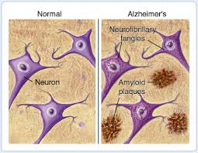
Alzheimer’s-DNA Damage
Amyloid plaque comprises straight unbranching fibrils from UV polymerization of monomeric peptide that damage DNA of neurons
$$E$$
$$E$$
$$E=\frac{hc}{2nd}$$

Slide 22
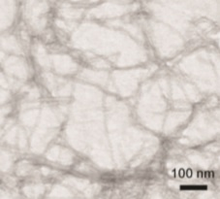
Alzheimer’s (cont’d)
UVC → λ = 254 nm
$$E$$
$$E=\frac{hc}{2nd}$$
λ = 2nd
$$E$$
d
$$E$$
Amyloid Fibrils
d
DNA Damage
( Pyrimidine dimer DNA damage)
d < 90 nm
NP diameter - d - nm
d ∼ 90 nm

Slide 23
Political Discussions
Obama and Monsanto
Trump and Vaccinations

Slide 24
US Politics - Obama
In 2010, Obama appointed Michael Taylor, former Monsanto vice president as the FDA commissioner for foods?
Before leaving office In 2016, Obama signed the Monsanto Protection Act into law →
The law states that even if future research shows GM food cause significant health problems, e.g., cancer, the federal courts have no power to stop use the sales of GM food.
US politics blocked science in GM food safety
Solution: 4.7 BN USD award on cancer from talc!!!

Slide 25
US Politics - Trump
President Trump is quoted as saying:
"When I was growing up, Autism wasn't really a factor," he [Trump] said. "And now all of a sudden, it's an epidemic. Everybody has their theory, and my theory is the shots. They're getting these massive injections at one time. I think it's the vaccinations.“
Trump should encourage future legislation be enacted that bans NPs not only from vaccines, but also from Baby and GM foods.
But Trump like Obama is likely to become stuck in the Washington swamp

Slide 26
Questions & Papers
Email: nanoqed@gmail.com
http://www.nanoqed.org
Notes:
Enter speaker notes here.

