Slide 1
Nanoparticles and Dark Matter
Thomas Prevenslik
QED Radiations
Hong Kong and Berlin
1
Notes:
Enter speaker notes here.

Slide 2
Preface
Nanotechnology as the science of the very small and the search for dark matter in the Universe may appear to be unrelated, but find commonality in NPs
NPs = nanoparticles
In nanotechnology, NPs are thought to conserve heat by increasing in temperature
But the Planck law of QM requires the heat capacity of the quantum sized NPs to vanish ?
QM = quantum mechanics
2

Slide 3
History
In 1926, Hubble discovered the Universe was expanding based on velocity measurements inferred from Doppler redshifts of light from recessing galaxies.
As the galaxy light travels to the Earth especially surrounding galaxies, it interacts with cosmic dust NPs
Astronomers assumed the light-matter interaction followed classical physics causing temperature changes that today has indirectly led to dark matter
But if QM is assumed, no dark matter
3

Slide 4
Introduction
Dark matter has a long history
In the 1930’s,
1. The Milky Way was found to rotate faster than expected suggesting dark matter was present , and
2. To keep the Coma cluster of galaxies together, the mass of dark matter would have to be much higher than visible matter
Similar to Hubble, early velocity measurements of galaxies were based on redshift of optical wavelengths
4
Since 1950, the computation of rotation curves became vogue after the radio astronomy discovery [4] of the 21 cm line of neutral hydrogen atoms. Unlike optical redshifts based on emission wavelengths, radio redshifts are determined from the frequencies of thermal emission.
In the 1970’s, rotation curves based on both optical and radio redshifts were resolved [5] for the M31 spiral galaxy by assuming the presence of invisible mass thereby marking the beginning of the modern search for dark matter.
Today, scientists generally agree that dark matter is invisible having about 5-times the mass of ordinary matter, but what it is and how it was formed has remained a mystery. Many dark matter dark matter theories are proposed. dark matter may not exist.

Slide 5
Introduction (cont’d)
In 1950, the radio astronomers discovered the 21 cm line of neutral hydrogen atoms supported dark matter
In the 1970’s, optical and radio redshifts were resolved for the M31 spiral galaxy by assuming dark matter.
Scientists generally agree that dark matter is invisible having about 5-times the mass of ordinary matter, but what it is and how it was formed has remained a mystery.
5

Slide 6
QM v. Classical Physics
Classical physics allows atoms in quantum sized dust NPs and hydrogen atoms to fluctuate in temperature
QM forbids temperature fluctuations as the heat capacities vanish which requires conservation of galaxy photons by non-thermal mechanisms, e.g.,
1. Cosmic dust is conserved by the optical re-emission of redshifted galaxy photons by NPs,
2. The hydrogen atoms conserve by optical emission of the 21 cm hydrogen line.
Both require optical telescopes.
Radio telescopes only measure temperature fluctuations!!!
6

Slide 7
Proposal
Dark matter is not a physical property of the Universe that can be discovered by experiment and only exists because optical redshifts are not corrected for cosmic dust.
Radio redshifts of the 21 cm hydrogen line are simply problematic having no meaning in cosmology
7

Slide 8
Optical Redshift
Measured redshift
$$Z_{meas}=\frac{Δ}{}=\frac{\left({Δ}_{V}+{Δ}_{D}\right)}{}$$
Δλ_{V} = wavelength increment of galaxy recession
Δλ_{D} = wavelength increment of cosmic dust
Z_{V} = Δλ_{V}/λ recession redshift
Z_{D} = Δλ_{D}/λ cosmic dust redshift
$$Z_{meas}=Z_{V}+Z_{D}$$
8

Slide 9
Doppler Shift
Galaxy velocity measurement
$$\frac{V}{c}=\frac{{\left(Z_{meas}+1\right)}^{2}−1}{{\left(Z_{meas}+1\right)}^{2}+1}$$
For Zmeas << 1,
$\frac{V}{c}∼ Z_{meas}=\frac{Δλ}{λ}$ →
$V  c Z_{meas}$
In 1970, M31 redshift with NII line at 6583 Å
$Z=\frac{Δλ}{λ}$ ∼ $0.001= \frac{6.583}{6583}$ → V = $3 x {10}^{8}∗0.001=300 km/s$
9

Slide 10
Heat Capacity
$$E=\frac{\frac{hc}{λ}}{exp\left(\frac{hc}{λkT}\right) −1}$$
Classical physics (dotted lines) allows NP atoms for any EM confinement to always have kT heat capacity.
QM differs by only allowing kT heat capacity at macro scale
How do NPs provide EM confinement < 0.1 microns?
10

Slide 11
EM Confinement
EM confinement of atoms in cosmic dust is a natural consequence of high S/V ratios of NPs
S/V = surface-to-volume
Upon absorption of galaxy light, almost all of the photon energy is deposited in the NP surface
EM confinement occurs as the NP temperature cannot increase to relieve the surface heat by thermal expansion.
11

Slide 12
Simple QED
The QED of light-matter interaction is usually thought to proceed by the complex relativistic theory based on virtual photons advanced by Feynman and others
Simple QED differs: A real photon conserves the heat from absorbed galaxy light and is verifiable
Briefly stated:
Under the QM restriction that the heat capacity of the atom vanishes, the heat of galaxy photon absorbed in a NP surface creates standing EM radiation inside the NP having half wavelength λ/2 = d
In simple QED, photons are real !!!
12

Slide 13
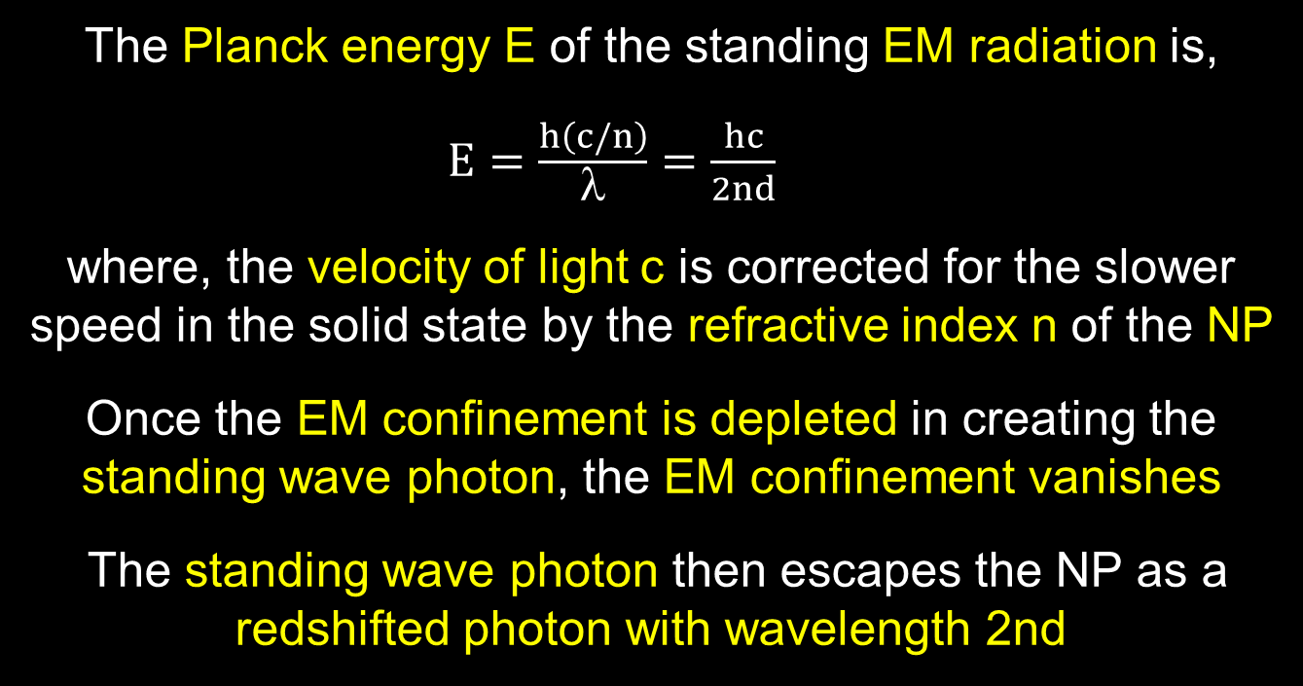
Simple QED(Cont’d)
The Planck energy E of the standing EM radiation is,
$E=\frac{h\left(c/n\right)}{λ}=\frac{hc}{2nd}$
where, the velocity of light c is corrected for the slower speed in the solid state by the refractive index n of the NP
Once the EM confinement is depleted in creating the standing wave photon, the EM confinement vanishes
The standing wave photon then escapes the NP as a redshifted photon with wavelength 2nd
13

Slide 14
Valid Redshift?
Ly-α
λ = 0.1217 micron
H-α
λ = 0.656 micron
$$Propose :Measure Z, ZL_{y} ,ZH_{}$$
If $ZL_{y}=ZH_{}$ , No cosmic dust → valid Z
Problem is Z is usually only measured for 1 line
14

Slide 15

Summary
In cosmic dust, simple QED redshifts the galaxy photon because QM precludes conservation by temperature.
QED is a simple form of the complex light and matter interaction advanced by Feynman and others
Galaxy Photon → NP w/o heat capacity → Redshift Photon
f = (c/n)/λ λ / 2 = d E = h f
Galaxy Photon
(λ)
Redshift
Photon
(2nd)
λ/2
High S/V ratios
$$Z_{D}=\frac{\left(2nd−λ\right)}{λ}$$
No
Temperature
Change
15

Slide 16
Discussions
Radio Redshift
Accelerating Universe Expansion
Dark Matter
Ghost Galaxy
Wave-Particle Duality
16

Slide 17
Radio Redshift
The Wouthuysen-Field (W-F) effect couples the spin temperature Ts of the 21 cm line of neutral hydrogen at 1420 MHz to the kinetic temperature Tk
The Planck law invalidates the W-F effect as the kinetic temperature T_{k} cannot fluctuate by QM
The 21 cm hydrogen line can only have a non-thermal origin and therefore radio redshift has no meaning →
Cosmology must rely on optical redshift
17

Slide 18
Accelerated Expansion
In 2001, SN was found brighter than it should have been → accelerated Universe expansion.
Redshift Z_{D} > 0 → SN appears further away, Z_{meas} = Z_{V} + Z_{D},
But Brighter because the SN is actually at Z_{V}
Accelerating Universe is not real, but rather an illusion caused by cosmic dust.
Brightness
O
Z_{V}
SN
Redshift
O
Z_{V}
+ Z_{D}
SN
18

Slide 19
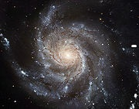
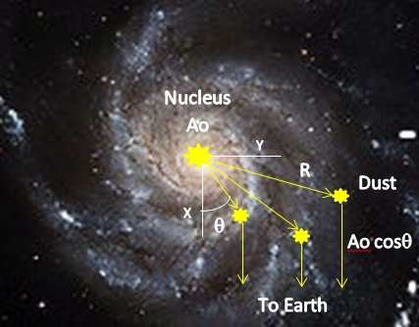
Dark Matter
In 1970’s, Spiral galaxy M31 has a flat velocity curve with a decreasing NII line intensity
V
Z_{D}
Z_{V}
Velocity
$$y=R sin$$
V(y)$=cZ=c\left(2nd−λ\right)$/$$
Flat curve
Line Intensity
$$A=Ao cos$$
Decreasing
Flat curve caused by dust, not dark matter
19

Slide 20
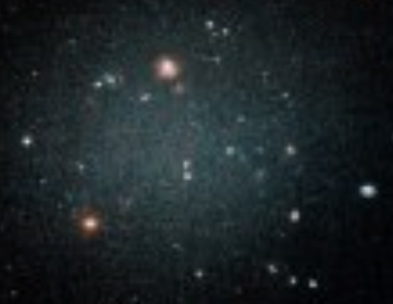
Ghost Galaxy
DF2 Galaxy – No Dark matter
Questions
No dark matter?
Transparent
Can the audience explain?
???
No dark matter because no cosmic dust !!!
20

Slide 21
Wave-Particle Duality
Simple QED is the mechanism by which a photon as a particle becomes a wave depending on interaction with matter
Galaxy Photon
E = hν
Redshift
Photon
E = hν’
Wave
In vacuum, photon is a particle, not a wave
In matter, photon is a wave, not a particle
21

Slide 22
Conclusion
By refuting current cosmological theories for dark matter and Universe expansion, perhaps cosmology may return to Einstein’s once upon a time static and dynamic Universe.
22

Slide 23
Questions & Papers
Email: nanoqed@gmail.com
http://www.nanoqed.org
23
Notes:
Enter speaker notes here.

