Slide 1
A Return of Cosmology to Newtonian Mechanics?
Thomas Prevenslik
QED Radiations
Hong Kong and Berlin
1
Notes:
Enter speaker notes here.

Slide 2
Dilemma
In the 1930’s, the orbital velocities of stars in our galaxy, and the speed of galaxies in the Coma cluster were found far greater than expected by Newtonian mechanics →
Dark matter exists to hold galaxies together
In the 1960’s, gravitational lensing in the Bullet cluster →
Existence of dark matter.
To date, particle experiments have not verified the hypothesis that dark matter does indeed exist.
Cosmology faces a dilemma
2

Slide 3
Background
In this dilemma, MOND is proposed as an alternative if the dark matter hypothesis is not experimentally verified.
MOND stands for Modified Newtonian Dynamics
MOND is based on the argument that the laws of gravity need to be modified in the very weak field regime to explain the high velocities
The purpose of the instant Dark Matter & Modified Gravity Conference is to choose between the research programs of Dark Matter and Modified Gravity, and also in choosing between different models within each program
3
Since 1950, the computation of rotation curves became vogue after the radio astronomy discovery [4] of the 21 cm line of neutral hydrogen atoms. Unlike optical redshifts based on emission wavelengths, radio redshifts are determined from the frequencies of thermal emission.
In the 1970’s, rotation curves based on both optical and radio redshifts were resolved [5] for the M31 spiral galaxy by assuming the presence of invisible mass thereby marking the beginning of the modern search for dark matter.
Today, scientists generally agree that dark matter is invisible having about 5-times the mass of ordinary matter, but what it is and how it was formed has remained a mystery. Many dark matter dark matter theories are proposed. dark matter may not exist.

Slide 4
Purpose
Argue the Dark Matter research program include Newtonian mechanics as the limit of Einstein’s general relativity at small velocities, and
Dark matter is the consequence of high velocities from overstated redshift in cosmic dust, but
If redshifts are corrected for cosmic dust, astronomical velocities and masses are given by Newtonian dynamics
4

Slide 5
History
Hubble discovered the Universe was expanding based on velocity measurements inferred from Doppler redshifts of light from recessing galaxies.
But on the way to Earth, the galaxy light is absorbed in NPs of cosmic dust
NPs = nanoparticles
Astronomers assumed the light-dust interaction followed classical physics causing temperature changes w ⁄ o redshift.
But if QM is assumed, temperature changes do not occur and the absorbed galaxy photon is conserved by re−emitting a redshifted galaxy photon
QM = quantum mechanics
5

Slide 6
QM v. Classical Physics
Classical physics allows atoms in quantum sized dust NPs to fluctuate in temperature
QM forbids temperature fluctuations as atomic heat capacities vanish which requires conservation of galaxy photons by non-thermal mechanisms, e.g.,
Cosmic dust conserves galaxy photons by redshifted optical re-emission w/o temperature change
6

Slide 7
Atomic Heat Capacity
$$E=\frac{\frac{hc}{λ}}{exp\left(\frac{hc}{λkT}\right) −1}$$
NPs
Classical physics (dotted lines) allows dust atoms for any EM confinement to always have kT heat capacity.
QM differs by only allowing kT heat capacity at macro scale
How does dust provide EM confinement < 0.1 microns?
7

Slide 8
EM Confinement
EM confinement of atoms in cosmic dust is a natural consequence of high S/V ratios
S/V = surface-to-volume
Upon absorption of galaxy light, almost all of the photon energy is deposited in the dust surface
EM confinement occurs as QM precludes a temperature increase to relieve the surface heat by thermal expansion.
8

Slide 9
Reddening v. Redshift
Dust Reddening is color change w/o change in wavelength
Dust redshift changes wavelength
$$Z_{meas}=\frac{Δ}{}=\frac{\left({Δ}_{V}+{Δ}_{D}\right)}{}$$
Δλ_{V} = wavelength increment of galaxy recession
Δλ_{D} = wavelength increment of cosmic dust
Z_{V} = Δλ_{V}/λ recession redshift
Z_{D} = Δλ_{D}/λ cosmic dust redshift
$$Z_{meas}=Z_{V}+Z_{D}$$
9

Slide 10
Doppler Shift
Galaxy velocity measurement
$$\frac{V}{c}=\frac{{\left(Z_{meas}+1\right)}^{2}−1}{{\left(Z_{meas}+1\right)}^{2}+1}$$
For Zmeas << 1,
$\frac{V}{c}∼ Z_{meas}=\frac{Δλ}{λ}$ →
$V  c Z_{meas}$
In 1970, M31 redshift with NII line at 6583 Å
$Z=\frac{Δλ}{λ}$ ∼ $0.001= \frac{6.583}{6583}$ → V = $3 x {10}^{8}∗0.001=300 km/s$
10

Slide 11
Simple QED
The QED of light-matter interaction is usually thought to proceed by the complex relativistic theory based on virtual photons advanced by Feynman and others
Simple QED differs: A real photon conserves the heat from absorbed galaxy photons.
In simple QED, photons are real !!!
Briefly stated:
Under the QM restriction that the heat capacity of the atom vanishes, the heat of galaxy photon absorbed in the dust surface creates standing EM radiation inside the dust having half wavelength λ/2 = d
11

Slide 12
Simple QED(Cont’d)
The Planck energy E of the standing EM radiation is,
$E=\frac{h\left(c/n\right)}{λ}=\frac{hc}{2nd}$
where, the velocity of light c is corrected for the slower speed in the solid state by the refractive index n of dust
Once the EM confinement is depleted in creating the standing wave photon, the EM confinement vanishes
The standing wave photon then escapes the dust as a redshifted photon with wavelength 2nd
12

Slide 13
Valid Redshift?
Ly-α
= 0.1217 μm
H-α
λ = 0.656 μm
Ly-α
ZD = (2nd-λ) / λ
d = 200 nm
n = 1.5
λ = 121.7 nm
↓
ZD = 4
V = 0.92 c
$Proposal :\text{If} ZL_{yα}=ZH_{α}$ → No cosmic dust → valid redshift
Problem: Z is usually only measured for 1 line
If > 1 line, compute average Z, but i$\text{f} not s\text{a}me,$ redshift invalid
13

Slide 14
Simple QED
In NPs, simple QED converts heat Q into EM radiation because QM precludes conservation by temperature.
Heat → NP(w/o heat capacity) → EM radiation
Single Photon
Simple QED
Radiation
E = hc/2nd
Heat
Q
λ/2
High S/V ratios
→
Surface Heat
EUV Fluorescence
↓
UV
ROS
Plasmons
CW laser
Nanotechnology Experiments
QM →
No Temperature
Change
Conserved by
Standing Wave
f = (c/n)/λ, λ / 2 = d, E = h f, N = Q / E
14

Slide 15
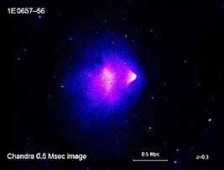
Bullet Cluster
The Bullet Cluster is thought to provides the best evidence for the nature of dark matter
15

Slide 16
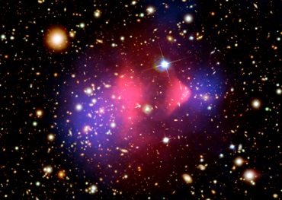
Bullet Cluster
Bullet cluster(NASA)
Star
Gas
DM
DM
X-ray image (pink) superimposed over a visible light image (galaxies), with matter distribution calculated from gravitational lensing (blue).
16

Slide 17
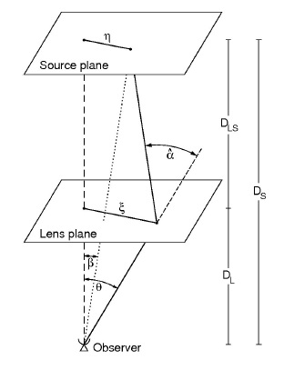
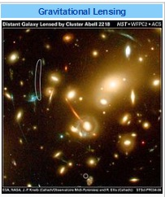
Gravitational Lensing
Einstein Radius ΘE
ΘE
Mass M(ΘE) inside ΘE
depends on DLS, DL, and DS.
VL = zL c
DL = zL c ⁄ Ho
VS = zS c
DS = zS c ⁄ Ho
If we know all of the angles ( α, β, and Θ ) and one distance, then we can deduce all of the distances including D_{L} and D_{S}. If we know an absolute distance D to the lens or source and we know the redshift z, we can deduce Hubble's constant Ho
Ho = z c⁄ D
.
17

Slide 18
Errors
Gravitational Lensing allows calculating Hubble’s Ho by knowing its redshift and hence its recession velocity, i.e., Ho ∼ 50 to 90 kms⁻¹Mpc⁻¹.
Currently, the approach is complicated using a "distance ladder" of parallax, cluster fitting, Cepheid variables and type Ia supernovae and subject to accumulation of error, as each step is used to calibrate the next
The one-step gravitational lens is desirable
Problem : Gravitational Lensing also relies on dust redshift in measuring DS → overstated mass of DM
18

Slide 19
Light Bending & NPs
Source
Light
Cosmic dust NPs overstate ZS
↓
Higher DM !
Simple QED
Radiation
E = hc/2nd
Star
Lens
Heat
NPs
19

Slide 20
Discussions
Radio Redshift
Accelerating Universe Expansion
Dark Matter
Ghost Galaxy
Wave-Particle Duality
Bullet Cluster
20

Slide 21
Radio Redshift
The Wouthuysen-Field (W-F) effect couples the spin temperature Ts of the 21 cm line of neutral hydrogen at 1420 MHz to the kinetic temperature Tk
The Planck law invalidates the W-F effect as the kinetic temperature T_{k} cannot fluctuate by QM
The 21 cm hydrogen line can only have a non-thermal origin and therefore radio redshift has no meaning →
Cosmology must rely on optical redshift !!!
21

Slide 22
Accelerated Expansion
In 2001, SN was found brighter than it should have been → accelerated Universe expansion.
Redshift Z_{D} > 0 → SN appears further away, Z_{meas} = Z_{V} + Z_{D},
But Brighter because the SN is actually at Z_{V}
Accelerating Universe is not real, but rather an illusion caused by cosmic dust.
Brightness
O
Z_{V}
SN
Redshift
O
Z_{V}
+ Z_{D}
SN
22

Slide 23
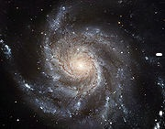
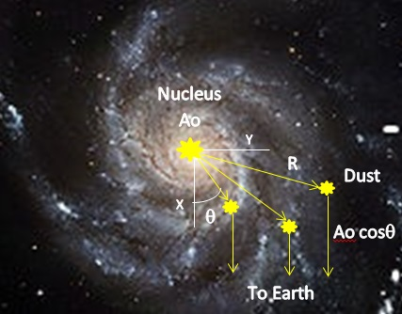
Dark Matter
In 1970’s, Spiral galaxy M31 found to have a flat velocity curve with a decreasing NII line intensity
V
Z_{D}
Z_{V}
Velocity
V(y)$=cZ=c\left(2nd−λ\right)$/$$
→ Flat velocity curve
Line Intensity
$$A=Ao cos$$
→ Decreasing intensity
Flat curve caused by dust, not dark matter
23

Slide 24
Line Intensity
The intensity of the NII line in M31 was found to decrease with galaxy radius.
Since the EM energy of the galaxy photon is absorbed in the NP surface, Fermat’s principle requires the emission to occur in minimum time →
Emission is across the minimum dimension between NP surfaces. For spherical NPs, in the direction of the incoming NII line
For plate−like NPs, normal to the plate surface.
24

Slide 25
Shape Intensity
$$y$$
θ
Line Intensity
$A=Ao cos ($-β)
NII Line
Line Intensity
$$A=Ao cos $$
$$x$$
β
θ - β
$$A$$
Earth
25

Slide 26
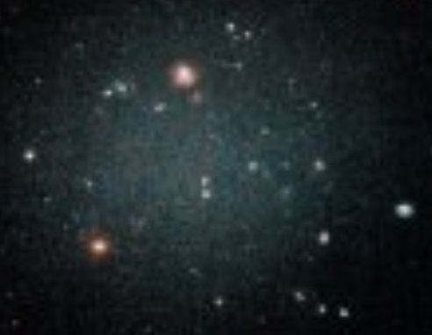
Ghost Galaxy
DF2 Galaxy – No Dark matter
Questions
No dark matter?
Transparent
Can the audience explain?
???
No dark matter because no cosmic dust !!!
26

Slide 27
Wave-Particle Duality
Simple QED is the mechanism by which a photon as a particle becomes a wave depending on interaction with the size of matter
Galaxy Photon
E = hν
Redshift
Photon
E = hν’
Wave
In vacuum, photon is a particle, not a wave
In matter, photon is a wave, not a particle, but wave properties depend on the size of matter
27

Slide 28
Bullet Cluster
Q→
←Q
X-ray image (pink) superimposed on visible image (stars)
DM from gravitational lensing (blue) in colliding galaxies
X-ray heating Q of NPs in galaxies → overstated redshift
DM is questionable!!!
28

Slide 29
Conclusion
Because of cosmic dust, perhaps cosmology may return to Einstein’s once upon a time static Universe.
29

Slide 30
Questions & Papers
Email: nanoqed@gmail.com
http://www.nanoqed.org
31
Notes:
Enter speaker notes here.

