Slide 1
Broadband endogenous UV in Mitochondria
Thomas Prevenslik
QED Radiations
Berlin 10777, Germany
1
Notes:
Enter speaker notes here.

Slide 2
Introduction
In 1960’s, biological research was the origin of life.
Mitchell proposed ATP synthesis in mitochondria by chemiosmosis powered by hydrolysis from flow of H+ ions across the inner membrane
Chemiosmosis occurs by a chain of complex redox reactions with electron transfer from donors to acceptors assisted by conveniently available enzymes.
In contrast, Sagan et al. proposed life on the early Earth began by dehydration reactions under intense UV radiation and showed experimentally,
ADP + P + UV → ATP + H₂O.
2

Slide 3
Discussion
But Chemiosmosis was selected over UV dehydration
Nature most likely did not choose chemiosmosis as the mechanism for ATP synthesis as the more direct path is UV enhanced dehydration
But UV dehydration directly damages DNA , and indirectly by creating reactive oxygen species (ROS).
But chemiosmosis creates ROS by errant interaction of oxygen with electrons in the chain of electron reactions.
Life is close balance of ATP synthesis and DNA damage
3

Slide 4
Origin of Life Arguments
Pro: Recent UV polymerization of nucleotides to RNA
Con:
UV destroys as much RNA as it creates
and
If UV was the primordial source of energy, why does no life today undergo ATP synthesis by UV radiation?
Resolved:
Survival required ATP synthesis exceed DNA damage on the early Earth that continues today !!!
4

Slide 5
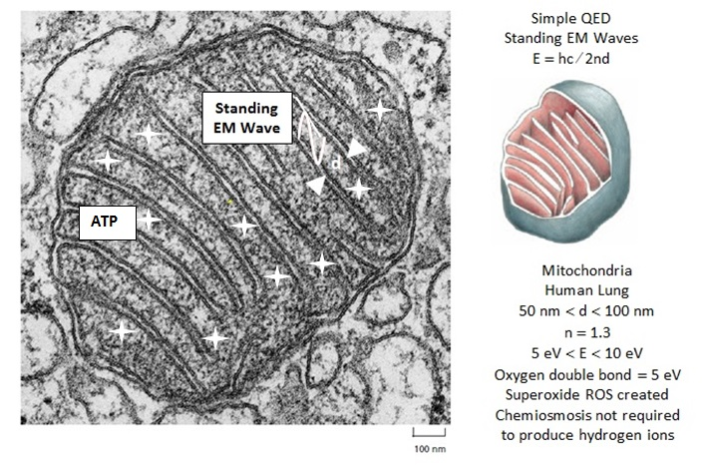
Mitochondria
Mitochondria evolved endogenous UV to replace solar UV upon ozone formation. Today, simple QED produces exogenous UV in the form of EM waves standing between adjacent cristae.
5

Slide 6
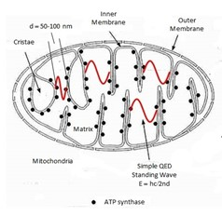
ATP Synthesis
Endogenous UV in mitochondria follows simple QED heat transfer converting metabolic heat to UV radiation
Human lung having spacings d ∼ 50-100 nm between adjacent cristae produces λ= 2nd → UVC (254 nm)
6

Slide 7
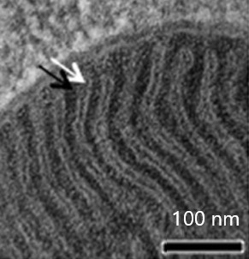
Drosophila
But mitochondria of the fruit fly Drosophila have smaller cristae spacings d = 13 nm → λ = 2nd ∼ EUV (66 nm)
EUV > UVC
7

Slide 8
Fluorescence
Drosophila having small cristae spacings produce simple QED radiation in the EUV and enhance ATP synthesis by fluorescing down to UVC levels.
However, fluorescence is inefficient.
High efficiency requires EM waves stand over longer spacings to produce UV to least upper bound UVC
UVC enhances ATP synthesis, but also synthesizes ∼1500 proteins necessary in diverse cell functions.
8

Slide 9
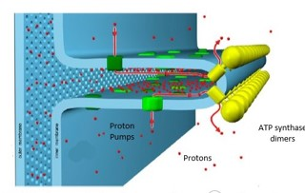
ATP Synthase Dimers
In 2019, ATP synthase dimers were found on tightly curved cristae tips.
In chemiosmosis, the protons (red) are pumped (green) into the cristae space and flow through the synthase rotor to produce ATP.
9

Slide 10
Standing UV Radiations
UV dehydration differs as EM radiation stands (red) between adjacent dimers
Dimers on adjacent cristae closest each other uniquely define the nodes of (red) standing EM radiation instead of the geometrically unlikely (blue) standing EM waves.
10

Slide 11
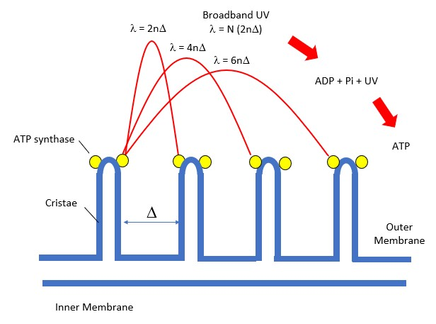
Broadband UV
In mitochondria, broadband UV takes advantage of EM waves standing over a number N of cristae spaces of dimension Δ
11

Slide 12
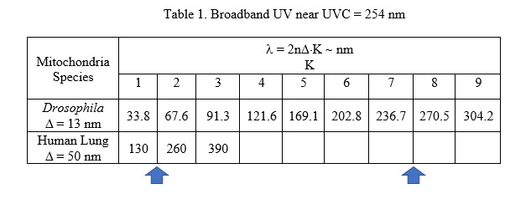
Summary
The blue arrows show the K value at which UVC occurs for Drosophila and the human lung.
For Drosophila from K = 8 at 270.5 nm, and for human lung from K = 2 at 260 nm.
12

Slide 13
Conclusions
Broadband UV enhances dehydration ATP synthesis by increasing the efficiency of fluorescence.
The UV level for mitochondria species may not be UVC.
Experiments are required to determine the optimum UV wavelength for dehydration ATP synthesis.
14

Slide 14
Questions & Papers
Email: nanoqed@gmail.com
http://www.nanoqed.org
15
Notes:
Enter speaker notes here.

